Slide 1
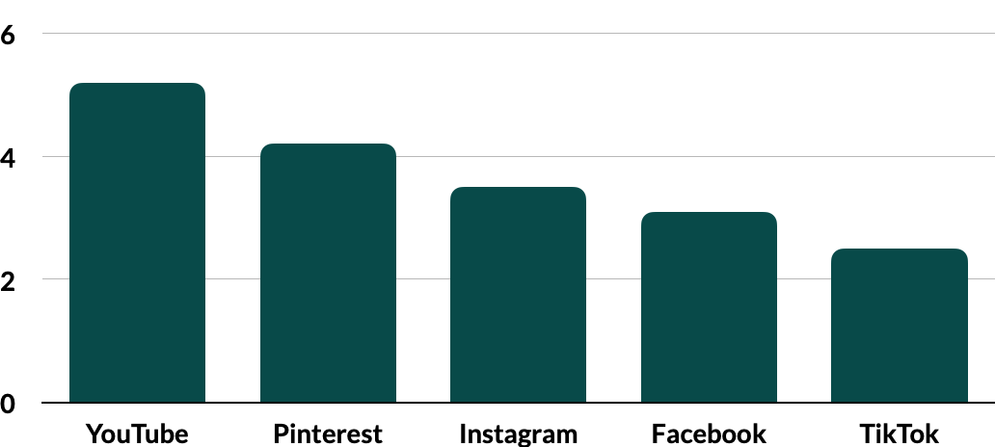
Grocery eCommerce Benchmarks and Insights
From the MikMak Shopping Index
Category Benchmark
3.7%
Purchase
Intent Rate

Slide 2
Grocery eCommerce Benchmarks and Insights
Consumer preference for Grocery eCommerce has shifted
Category Benchmark
3.7%
Purchase
Intent Rate
According to eMarketer, Grocery eCommerce will be a $243 billion market in the US by 2025.
YouTube surpasses Facebook/Instagram as yielding the highest Purchase Intent Rates among social channels.
Grocery shoppers purchase many items at a time, with an Average Basket Size of 12.4 items.

Slide 3
Grocery eCommerce Benchmarks and Insights
YouTube x Walmart is your channel/retailer mix for Grocery shoppers
x
Social commerce can help your Grocery brand reach a higher volume of online grocery shoppers. Right now, YouTube has the highest Purchase Intent Rate (PI Rate)* at 5.2 percent (1.4 x higher than the category benchmark) for Grocery brands, meaning shoppers are most likely to continue to purchase from media displayed on YouTube. YouTube, being the premier platform to host long-form video content, is great to leverage when educating your consumer on your product. Where shoppers might scroll past content they see elsewhere, YouTube requires audience attention for a more sustained period of time.
Following YouTube is Pinterest, with a 4.2 percent PI Rate. Similar to YouTube, Pinterest is a highly visual platform that is great for more content-rich advertising such as shopping lists, recipes, and party planning guides. When advertising on Pinterest, ensure your product’s value is clearly depicted in the creative by showing it in action.
*Purchase Intent Rate: The percentage of shoppers who clicked through to at least one retailer.
Following Pinterest is Instagram with 3.5 percent. Facebook, which yields the highest in-market traffic, has a PI rate of 3.1 percent, and finally, TikTok has a PI Rate of 2.5 percent.

Slide 4
Grocery eCommerce Benchmarks and Insights
Purchase Intent Rate by Social Channel
Wherever your consumers are engaging, be sure to include the retailers they prefer to shop at. Right now, Walmart is the retailer driving the most in-market traffic for Grocery brands, with a 41.2 percent Share of Purchase Intent Clicks* among the top 5 retailers. Target and Amazon are second and third, with 22.1 and 18.6 percent, respectively. Following the major retailers, quick delivery option Instacart yields 11.9 percent of shoppers, and local option, Kroger, rounds out the Top 5 retailers at 6.1 percent.
Want to better understand how to reach Walmart shoppers with social content? Listen to Kara Rousseau of Walmart Connect on BRAVE COMMERCE. | Target is a standout for seeking out and highlighting minority led brands. To learn how to capitalize on on these efforts tune into the BRAVE COMMERCE episode featuring Partake Foods CEO Denise Woodward.
Share of Purchase Intent by Retailer (Top 5)
Advertising on a mix of channels, especially including YouTube, and being available at a variety of retailers, especially including Walmart, can help your brand win market share with Grocery shoppers.
*Share of Purchase Intent Clicks: The number of times a shopper has clicked through to at least one retailer during a single session.

Slide 5
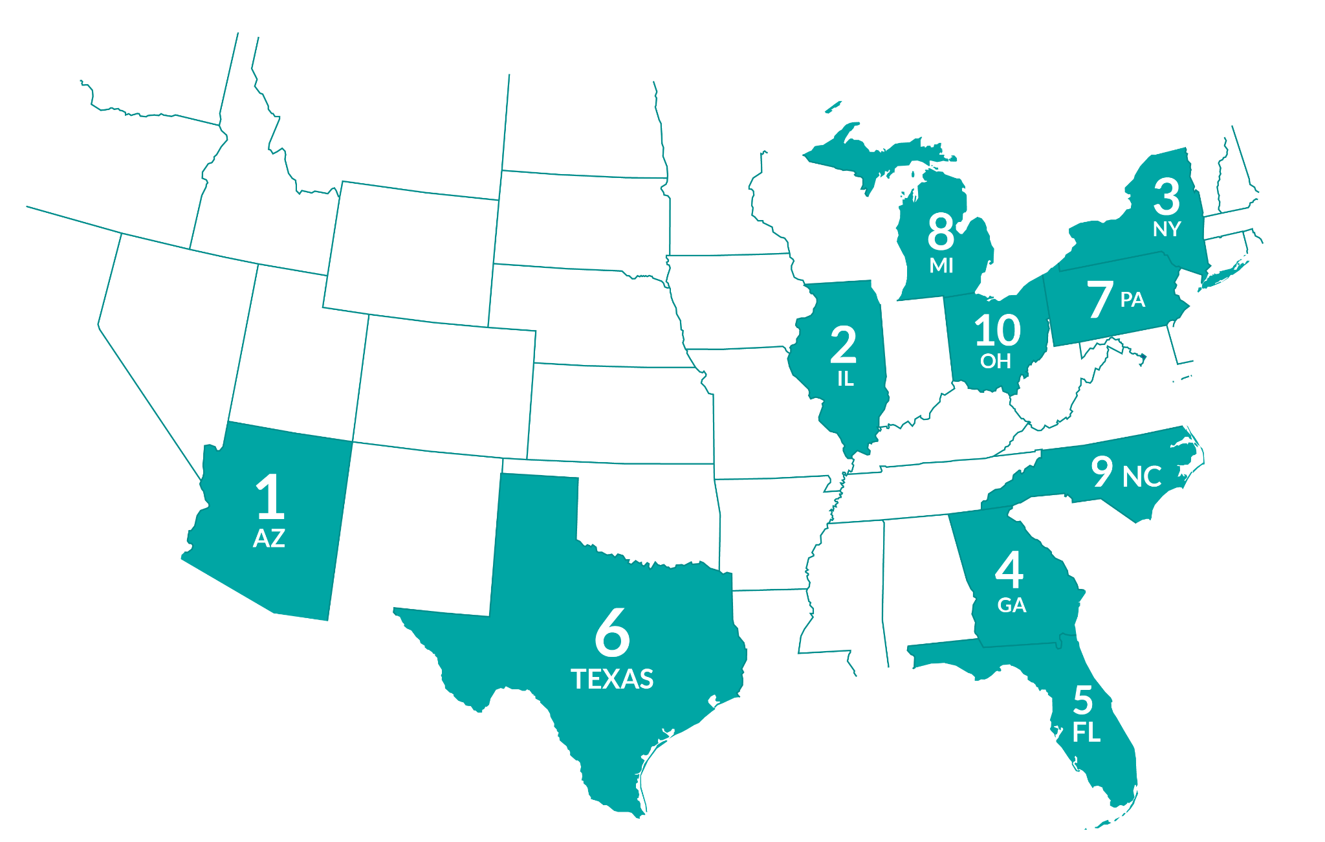
Grocery eCommerce Benchmarks and Insights
Grocery Shoppers are most likely to buy online Thursday at 1 PM ET
Grocery shoppers are adding Snack Mixes, Coffee, and more to their carts
While the weekends and evenings see more shopping traffic, PI Rates rise for Grocery items on Thursdays and during the 1 PM hour (EST). Consider retargeting consumers around this time.
Geographically, Arizona has the highest PI Rates for Grocery shoppers at 7.2 percent (1.9 x the category average). Illinois, New York, Georgia, and Florida also all see higher-than-average Purchase Intent Rates. Consider targeting your marketing and inventory planning to cater to these geographical regions, as shoppers living in those states are more likely to continue to purchase.
Top 10 Products by Type
1. 2. 3. 4. 5. | Snack Mix: Seasonal Flavor Sliced Cheese Single Serve Flavored Coffee, 12 ct Herbal Tea Single Serve Flavored Coffee, 24 ct | 6. 7. 8. 9. 10. | Single Serve Medium Roast Coffee, 24 ct PB and Chocolate Candy Snack Mix: Original Flavor Frozen Veggie Burgers Cereal
Top 10 US States (by Purchase Intent Rate)
AZ - 7.2%
IL - 4.3%
NY - 3.9 %
GA - 3.9%
FL - 3.8%
TX - 3.6%
PA - 3.5%
MI - 3.5%
NC - 3.4%
OH - 3.1%
When looking at basket-level data, the MikMak Shopping Index shows that the average Grocery cart is 12.4 items. What’s in those carts? A leading snack mix product, sliced cheese, and a variety of single-serve coffees are the top-purchased products right now.
Average Basket Size
12.4 items

Slide 6
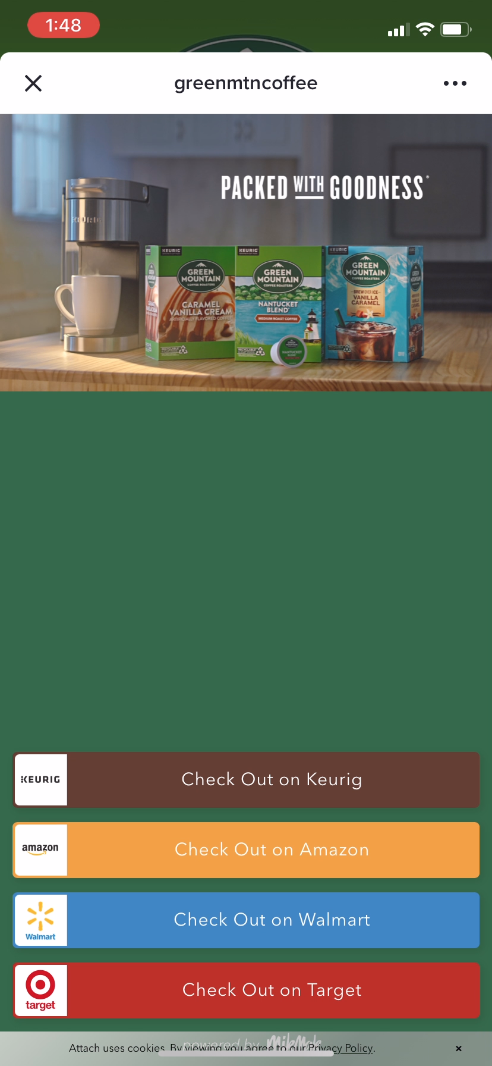
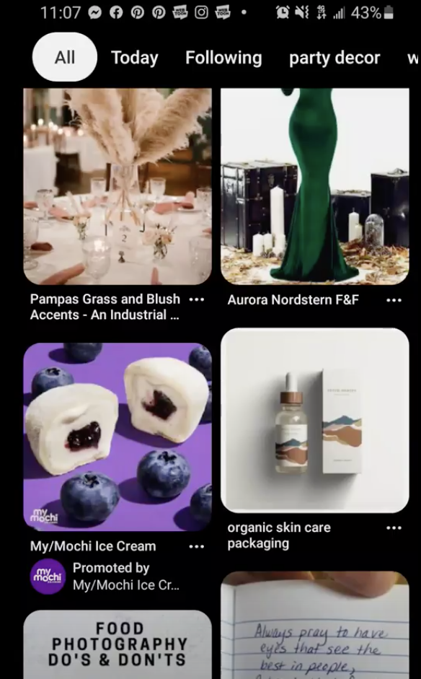
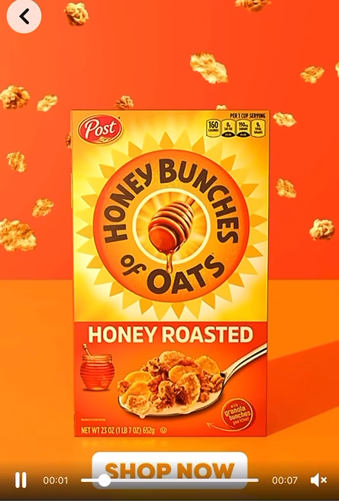
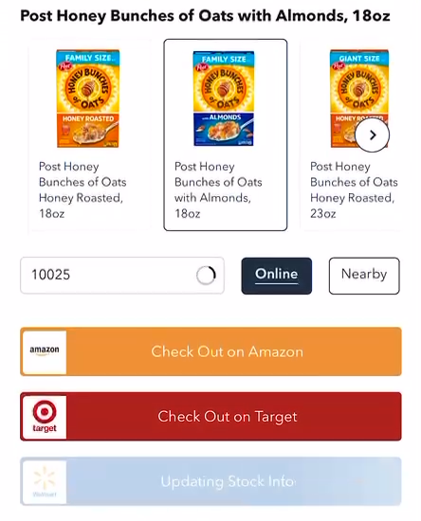
Grocery eCommerce Benchmarks and Insights
What makes effective eCommerce ads?
What do many of the top-performing Grocery eCommerce ads have in common? Let’s take a closer look and find out:
Bold, eye-catching creative that visually stands out
Product first, showcasing both the product and its value right away
Have a clear call to action. Include bold links with simple text such as “Buy Now” or “Check Out”.
Flexible checkout that allows shoppers to switch between in stores and online, different geolocations, and fulfillment options
Don’t be afraid to try out different formats. Successful Grocery brands have effectively used QR codes, OTT advertising, and livestream commerce to reach consumers.
Enable shoppable options on your brand website to promote brand awareness and offer additional checkout and fulfillment options for shoppers.
Hot tip: Be quick and nimble with your creative. The world needs to be able to experience your brand and buy it.
Enable eCommerce capabilities like shoppable media
MikMak customer, Green Mountain Coffee, ran shoppable media on YouTube with their “Packed with Goodness” campaign. This experience allows shoppers to check out at their favorite retailers or even on the brand’s website.
Notes:
STILL IMAGE VERSION FOR PDF

Slide 7
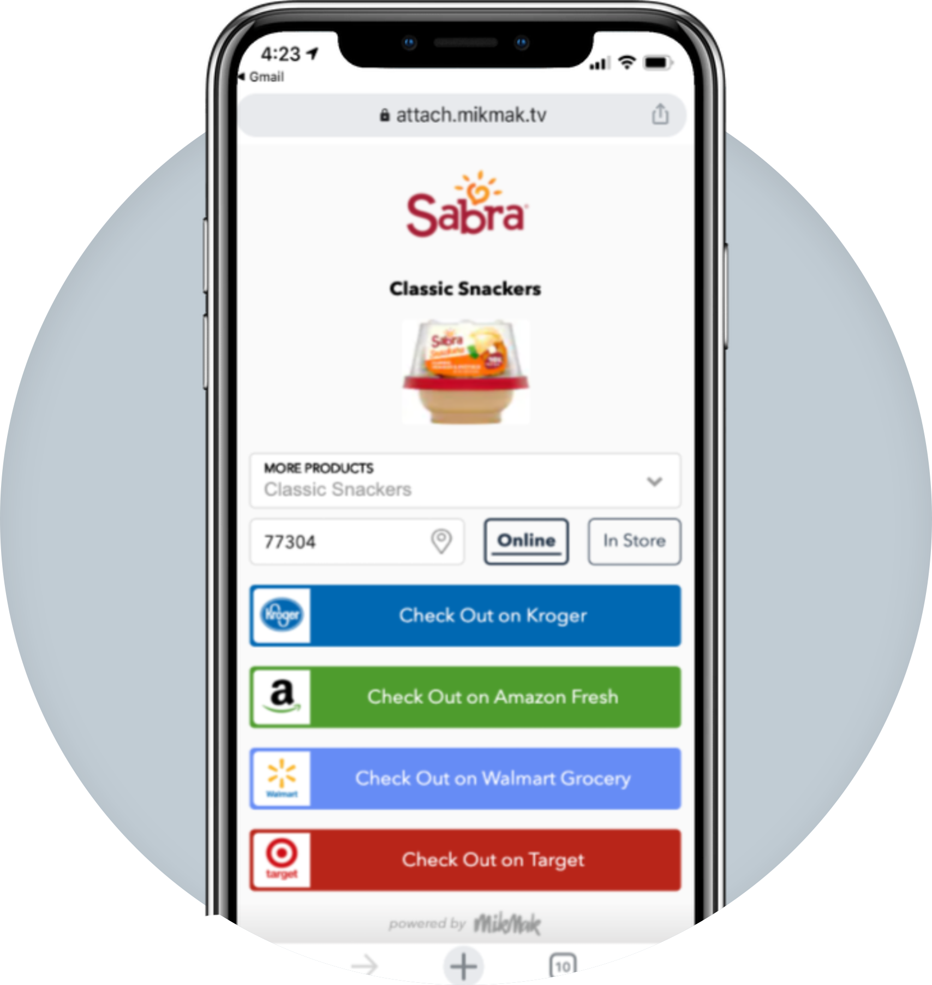
Grocery eCommerce Benchmarks and Insights
READ CASE STUDY
Featured Case Study Sabra drove higher purchase intent than competitors and improved media efficiency by leveraging MikMak Insights to make campaign optimizations.
2x
Increase in Purchase Intent Rate after switching campaign objectives
+86%
Increase in Purchase Intent Rate after updating campaign creative
"MikMak has fundamentally changed how Sabra does marketing. We now understand full funnel marketing. We understand what channels, audiences and objectives move someone towards purchase.“
Chief Marketing Officer, Sabra
+50%
Higher Purchase Intent Rate than the Grocery vertical on Facebook/Instagram

Slide 8
Grocery eCommerce Benchmarks and Insights
Your eCommerce Marketing Checklist
So you’ve got the insights, now what? Here’s a list to help you design and optimize your eCommerce marketing initiatives for 2023.
Get the basics down. Are YouTube, Pinterest, Instagram, Facebook, and TikTok part of your marketing mix? Are Walmart, Target, Amazon, Instacart, and Kroger in your check-out options?
Develop more nuanced insights for consumer relevance. Is your brand’s website utilizing multi retailer checkout? Which Grocery stores and specialty stores are your shoppers at? Which channels are part of their shopping journey? Add the channels and retailers that resonate with your consumers to the mix. Can this expand to new formats like livestream commerce and OTT commerce?
Explore growth opportunities. Check your performance against category (and subcategory!) benchmarks to see how you stack up against the competition. A/B test creative and messaging to see if purchase intent increases.
Want to learn more? MikMak can help you get started!

Slide 9
Want to keep learning about grocery insights?
All data and insights from this Category Benchmark and Insights are sourced from the MikMak Shopping Index.
The MikMak Shopping Index was developed to provide a standardized set of metrics, methodology, and benchmarks to help drive brands’ business results and strategy. It is a collection of key eCommerce KPIs collected across hundreds of brands and over 250 channels and more than 2,000 retailer integrations to understand consumer online shopping behavior. The Index also includes data from MikMak Shopper Intelligence, which ties first-party eCommerce data to 1,000+ demographic and psychographic data points and can be segmented by product, retailer, and more. Shopper Intelligence is available through an industry-exclusive partnership with LiveRamp.
Data in this report is from Jan 30, 2022 - Jan 30, 2023
Check out these BRAVE COMMERCE episodes:
LISTEN NOW
LISTEN NOW
LISTEN NOW
Walmart's Whitney Cooper on driving innovation and unity with her "one team" mindset | Mondelez’s Jie Cheng on different eCommerce adoption & maturity dynamics across global markets. | Sargento’s Chris Houser on the evolution of the grocery industry into eCommerce
Let’s chat!
Want to get even more insights?
Contact marketing@mikmak.com!

