Slide 1
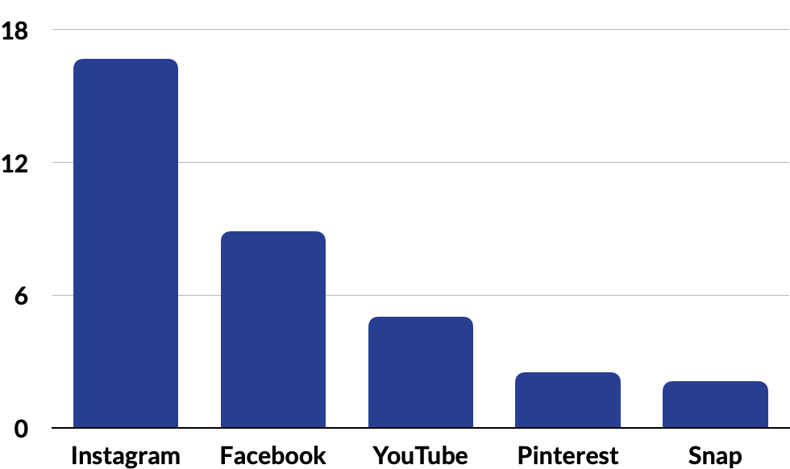
Alcohol eCommerce Benchmarks and Insights
From the MikMak Shopping Index
x
Category Benchmark
7.8%
Purchase
Intent Rate

Slide 2
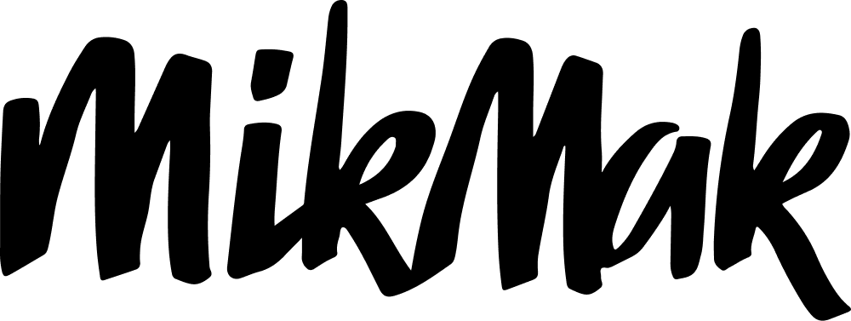
Alcohol eCommerce Benchmarks and Insights
Consumer preference for Alcohol eCommerce has shifted
Category Benchmark
7.8%
Purchase
Intent Rate
eCommerce Alcohol sales are predicted to grow by more than a third to reach $40 billion by 2026*
Instagram remains the top social platform for Alcohol eCommerce in 2023
Alcohol Shoppers are most likely to buy mid-week in the evening
Source: IWSR Drinks Market Analysis

Slide 3
Alcohol eCommerce Benchmarks and Insights
Purchase Intent Rate by Social Channel
Instagram x Drizly is the channel/retailer mix for Alcohol shoppers
Right now, Instagram yields the highest Purchase Intent Rate (PI Rate)* for Alcohol at 16.7 percent (2.1 x than the category benchmark), meaning shoppers are most likely to continue to purchase from shoppable media running on Instagram.
Following Instagram is fellow Meta platform, Facebook, with an 8.9 percent PI Rate (1.1 x the category benchmark). Next up is YouTube, with a PI Rate of 5 percent. Pinterest and Snap round out the list of top-performing social channels for Alcohol with PI Rates of 2.5 and 2.1, respectively.
*Purchase Intent Rate: The percentage of shoppers who clicked through to at least one retailer.
x

Slide 4
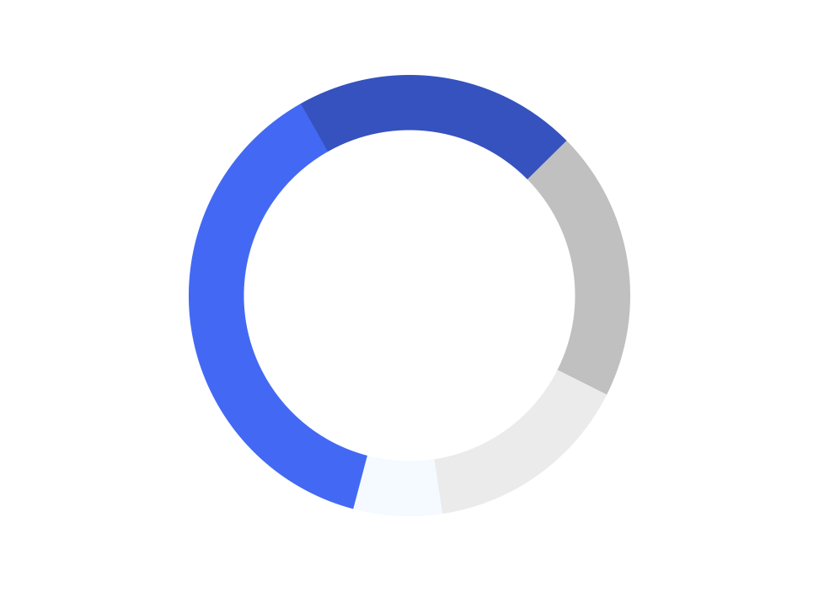
Alcohol eCommerce Benchmarks and Insights
Wherever your consumers are engaging, be sure your media drives them to the retailers where they prefer to check out. Right now, among the Top 5 Alcohol retailers, Drizly is the retailer driving the most in-market traffic for Alcohol brands, with 37.7 percent of Purchase Intent Clicks*. Walmart and Instacart are second and third with 20.8 and 19.8 percent, respectively. Quick delivery retailer, Total Wine, follows with 15.2 percent of shoppers, and local option, Kroger, rounds out the Top 5 retailers at 6.5 percent.
Share of Purchase Intent by Top 5 Retailers
Advertising on a mix of channels, especially Instagram, and being available at a variety of retailers, especially Drizly, can help your brand win market share with Alcohol shoppers.
*Purchase Intent Clicks: The number of times a shopper has clicked through to at least one retailer during a single session.

Slide 5
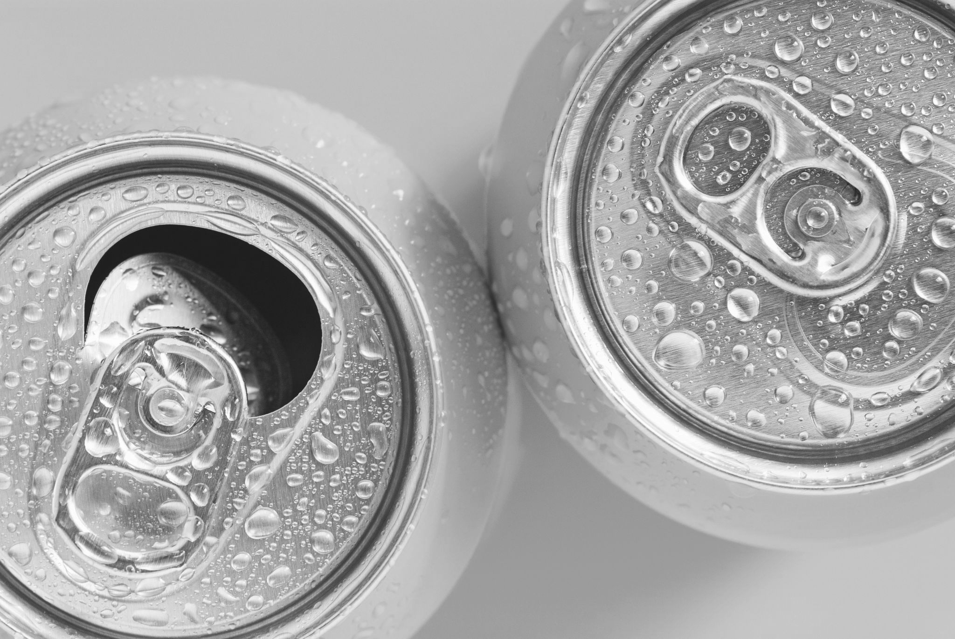
Alcohol eCommerce Benchmarks and Insights
Whiskey products and Canned Cocktails are especially popular with Alcohol shoppers
Average Basket Size
Top 10 Products by Type
5.9 items
1. 2. 3. 4. 5. | Whiskey-based Canned Cocktail Peanut Butter Whiskey Elderflower Liqueur Peach Whiskey Vodka | 6. 7. 8. 9. 10. | Vodka-based Canned Cocktail Premixed Long Island Iced Tea Whiskey Rum Beer, 12-Pack
When looking at basket-level data, the MikMak Shopping Index shows that the average Alcohol cart is 5.9 items. What’s in those carts? Varieties of Whiskey appear most commonly among the top 10 products, alongside Elderflower Liqueur, Vodka products, Rum, and Beer.

Slide 6
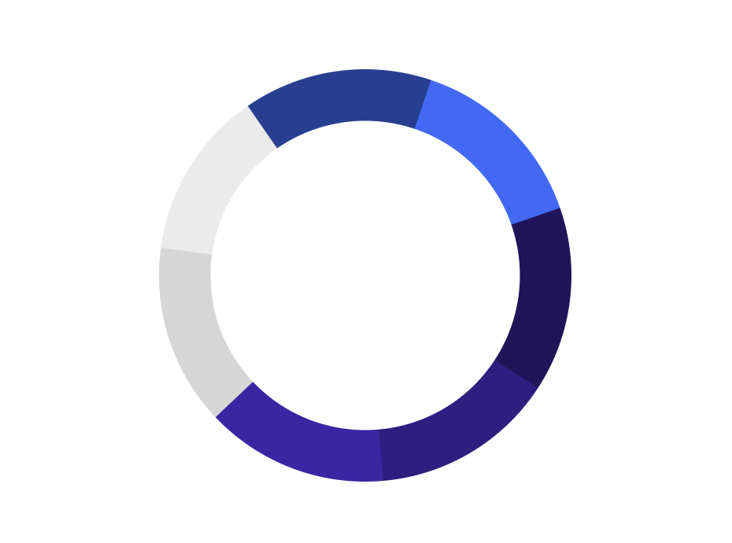
Alcohol eCommerce Benchmarks and Insights
Top Days of the Week for Alcohol eCommerce
Alcohol Shoppers are most likely to buy mid-week in the evening
by Purchase Intent Rate
Online Alcohol shoppers are most likely to purchase Tuesday, Wednesday, or Thursday, as all three of these days share a PI Rate of 8 percent. However, Thursdays see the most in-market traffic from online Alcohol shoppers, with 14.8 percent of Purchase Intent Clicks.
Looking at the time of day, Alcohol shoppers are likely to purchase at 6 or 7 PM ET, which both yield PI Rates of 8.4 percent.
Top 5 Hours for Online Alcohol Purchase
by Purchase Intent Rate
by Share of Purchase Intent Clicks

Slide 7
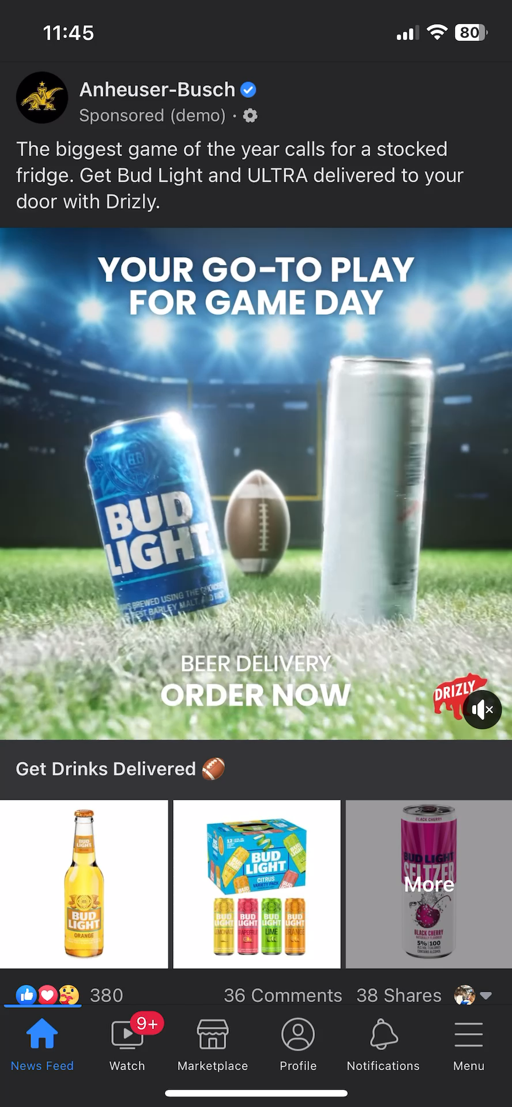
Alcohol eCommerce Benchmarks and Insights
What makes effective eCommerce ads?
What do many of the top-performing Alcohol eCommerce ads have in common? Let’s take a closer look and find out:
Bold, eye-catching creative that visually stands out
Product first, showcasing both the product and its value right away
A clear call to action entices customers. Include bold links with simple text such as “Buy Now” or “Check Out”.
Flexible checkout that allows shoppers to switch between in stores and online
Optimize your content with MikMak to allow consumers to find your product locally
Experiment with different formats. Successful Alcohol brands in 2023 have effectively used QR codes, and OTT advertising to reach consumers.
Enable shoppable options on your brand website to promote brand awareness and offer shoppers additional checkout and fulfillment options.
Hot tip: Be quick and nimble with your creative. The world needs to be able to experience your brand to buy it.
Educate on delivery
& stock up
Portfolio > Single Brand

Slide 8
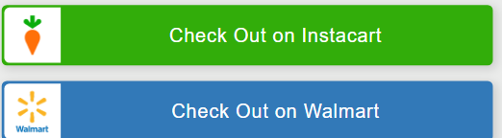
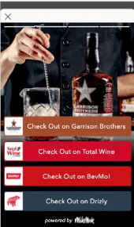
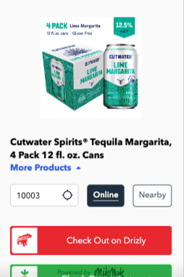
Alcohol eCommerce Benchmarks and Insights
MikMak customer, AB InBev, runs shoppable media on advertising channels, as well as enhanced retailer options on their brand website in order to meet consumers at multiple touchpoints, and ultimately create a seamless path to purchase.
ABI x MikMak Experience Data Super Bowl 2022
Super Bowl Search This top Creative experience was running for Budweiser, with 354 PI clicks, and an 8.5% Purchase Intent Rate
Carolyn Brown of AB InBev on innovation and inspiration in the beer & spirits industry
Listen Now
Watch Webinar on Demand
Garrison Brothers Distillery increased purchase intent by enhancing the shoppability of their ads and leveraging 1P data to optimize their media mix.
Cutwater Super Bowl This top Discover experience was running for Cutwater, with over 1.1K PI clicks, and a 3% Purchase Intent Rate
READ CASE STUDY
Watch Webinar on Demand

Slide 9
Alcohol eCommerce Benchmarks and Insights
Your eCommerce Marketing Checklist
So you’ve got the insights, now what? Here’s a list to help you design and optimize your eCommerce marketing initiatives for 2023.
Get the basics down. Are Instagram, Facebook, and YouTube part of your marketing mix? Are Drizly, Walmart, Instacart, Total Wine, and Kroger in your check-out options?
Develop more nuanced insights for consumer relevance. Is your brand’s website utilizing multi-retailer checkout? Which channels are part of their shopping journey? Add the channels and retailers that resonate with your consumers to the mix. Can you expand to new formats like QR codes and CTV?
Incorporate inventory management capabilities into your media and brand website, so shoppers can see where your products are in stock and consider purchasing backup SKUs if there is no availability. Don’t lose sales to the competition.
Explore growth opportunities. Check your performance against category (and subcategory!) benchmarks to see how you stack up against the competition. A/B test creative and messaging to see if purchase intent increases.
Want to learn more? MikMak can help you get started!
Listen Now
“Where digital has another interesting kind of added benefit is that it also has the ability to make those emotional connections outside of the transactional”
- Katie Kirkpatrick, Bacardi

Slide 10
All data and insights from Category Benchmark Reports are sourced from the MikMak Shopping Index
Let’s chat!
Want to get even more insights? Looking for a different retailer?
Contact marketing@mikmak.com!
The MikMak Shopping Index was developed to provide a standardized set of metrics, methodology, and benchmarks to help drive brands’ business results and strategy. It is a collection of key eCommerce KPIs collected across hundreds of brands and over 250 channels and over 2000 retailer integrations to understand consumer online shopping behavior. The Index also includes data from MikMak Shopper Intelligence, which ties first-party eCommerce data to 1000+ demographic and psychographic data points, and can be segmented by product, retailer, and more. Shopper Intelligence is available through an industry exclusive partnership with LiveRamp.
All data in this report is from 3/14/2022 to 3/14/2023.

