Slide 1
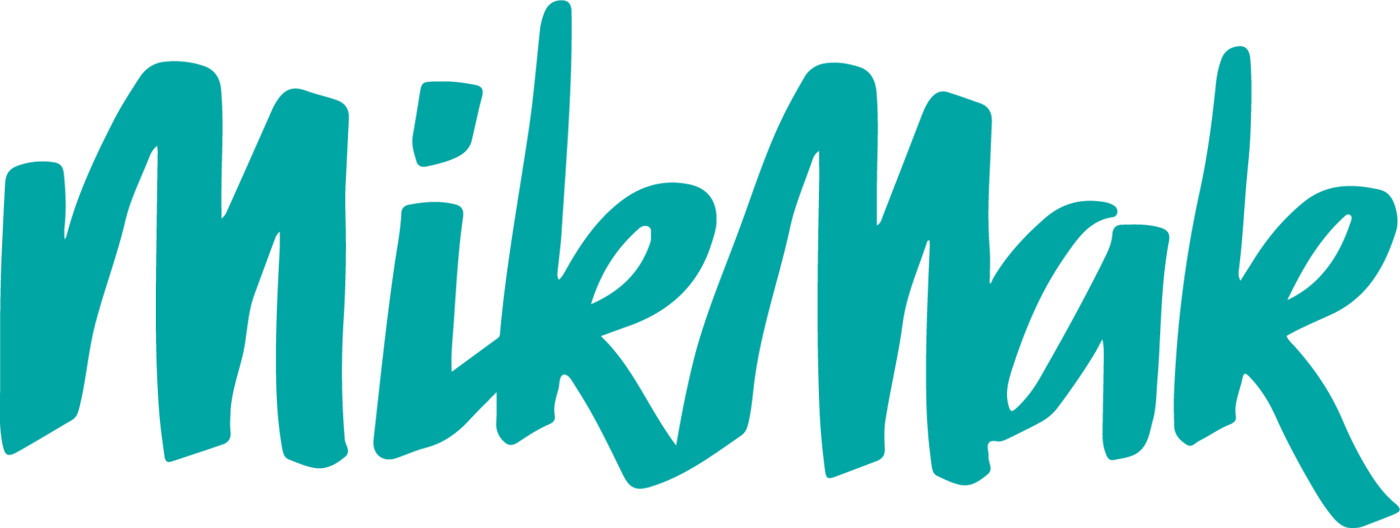
Growing Your Brand During the 2023 Holiday Season, Commerce-First
Benchmarks & Insights for Multichannel Brands to Convert Holiday Shoppers

Slide 2
2023 Holiday Season Overview
Table of Contents
03 | Holiday 2023 Overview
04 | Accelerate Sales and Market Share
04 | Make Your Products Discoverable
07 | Strengthen Retailer Partnerships
10 | Beat the Competition
14 | Drive Profitability and Reduce Costs
11 | Improve Marketing Effectiveness
14 | Collect First-Party Data
16 | Save Time & Money
With a backdrop of inflation, appealing to your consumer’s needs and knowing where to spend your next marketing dollar is vital to success this holiday season. This guide shares benchmark data and insights from the MikMak Shopping Index to help:
Accelerate sales and market share by making sure your products are discoverable by consumers and arming your teams with the right competitor and retailer insights
Drive profitability and reduce costs by collecting first-party data to improve your marketing effectiveness throughout the holiday season
Set your brand up to succeed in 2024 by keeping a pulse on the latest eCommerce marketing trends and creative best practices

Slide 3
Holiday 2023 Overview
As prices stabilize, core inflation is still affecting US consumers
According to the MikMak Shopping Index, eCommerce conversion rates have shown signs that consumers are more trepidatious when completing a purchase this year -- however, they are still spending. The economic backdrop emphasizes the need for brands to look for efficiencies in their marketing and media spend. The brands that can keep investing despite this backdrop will gain share and withstand the test of time.
Retail media has taken flight, and shows no signs of slowing
According to eMarketer, retail media ad spend will more than double by 2027. This growth is more rapid than the digital ad market overall. With retailers having significant access to first-party data, retail media is a huge frontier for marketers looking to reach shoppers when they are most likely to buy. However, as retail media grows, an advanced need for data transparency and standardization will matter most for brands.
Gen Z is gaining buying power, motivating marketers to innovate
According to the MikMak Shopping Index, Millennials and Gen Z have the highest eCommerce Purchase Intent Rates compared to other generations. Keep a close eye on the preferences and shopping trends surrounding different demographic segments this holiday season, and in years to come, as younger generations age into having more disposable income.
Learn more about how brands can win market share in economic uncertainty from this BRAVE COMMERCE episode featuring Sucharita Kodali of Forrester.
Interested in learning more about Retail media? Check out this BRAVE COMMERCE episode featuring Michal Gellar of Newell Brands.
Learn more about marketing to Gen Z from this BRAVE COMMERCE episode featuring Soyoung Kang of eos.
LISTEN NOW
LISTEN NOW
LISTEN NOW
Holiday 2023 Overview

Slide 4
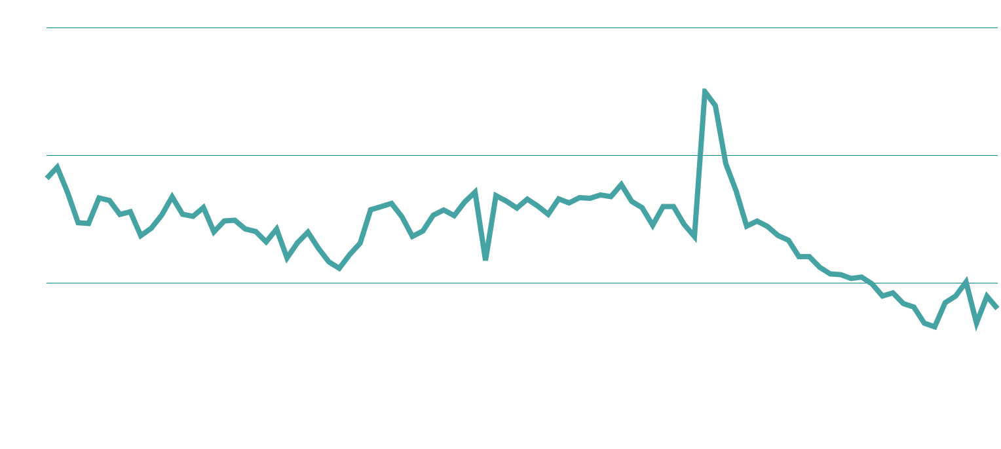
Accelerate Sales and Market Share
eCommerce Shopping Traffic Trends
Purchase Intent Rate Peaks (All Categories)
Make your products discoverable
As the holiday season approaches, it becomes increasingly important to make sure your brand reaches consumers where they are, when they are most likely to buy. To start, here’s a look at the top days and times people are shopping.
Last year, Purchase Intent Rates* peaked on December 3rd at 10 percent, with more sustained Purchase Intent Rates throughout the season than we saw in 2021. This is likely due to an early kickstart to the season with October’s Amazon Prime Day, followed by Black Friday and Cyber Monday deals carrying through longer periods of time. We expect to see similar this year.
= PI Peak
*Purchase Intent Rate = The number of times a shopper has clicked through to at least one retailer during a single session
Make your products discoverable

Slide 5
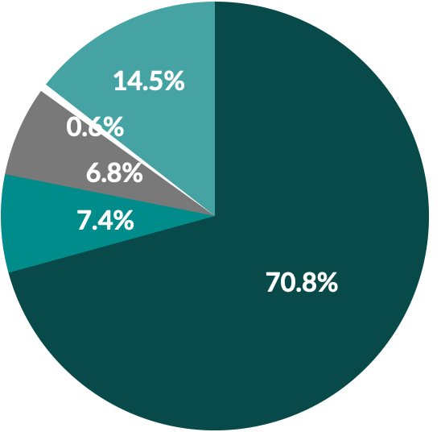
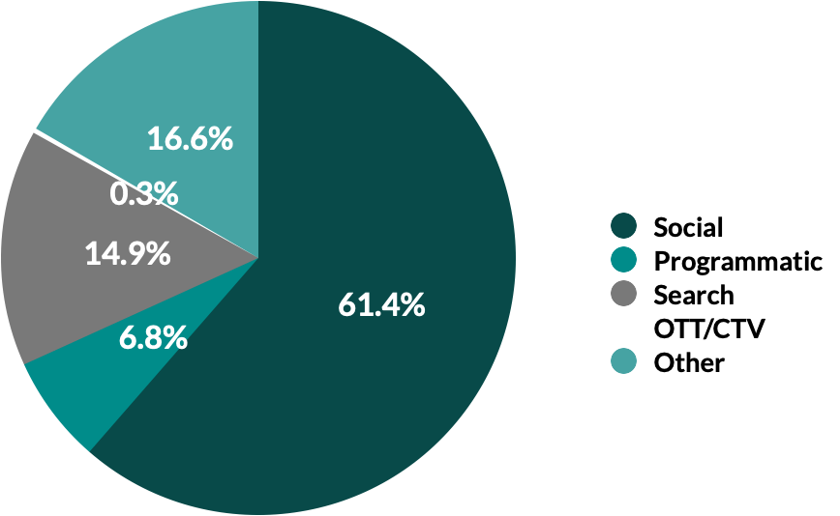
Predicted Peak Dates by Industry
Social Commerce is the third shelf
Toys & Gaming
Grocery
Beauty
Alcohol
2023 Media Mix
Saturday
12/2
Weds 11/1,
Sat 11/25*
(The day after Black Friday)
Friday
11/3
Friday
12/1
(9.4 p.p)
(0.6 p.p)
(8.1 p.p)
Ricola leveraged MikMak to quickly launch shoppable influencer campaigns across Instagram and TikTok.
(0.3 p.p)
Brand Success Story
(2.1 p.p)
2022 Media Mix
2.8x Higher Purchase Intent Rate on TikTok
1.6x Higher Purchase Intent Rate by influencer
55% Of consumers preferred to shop at Target
READ FULL CASE STUDY
Make your products discoverable

Slide 6
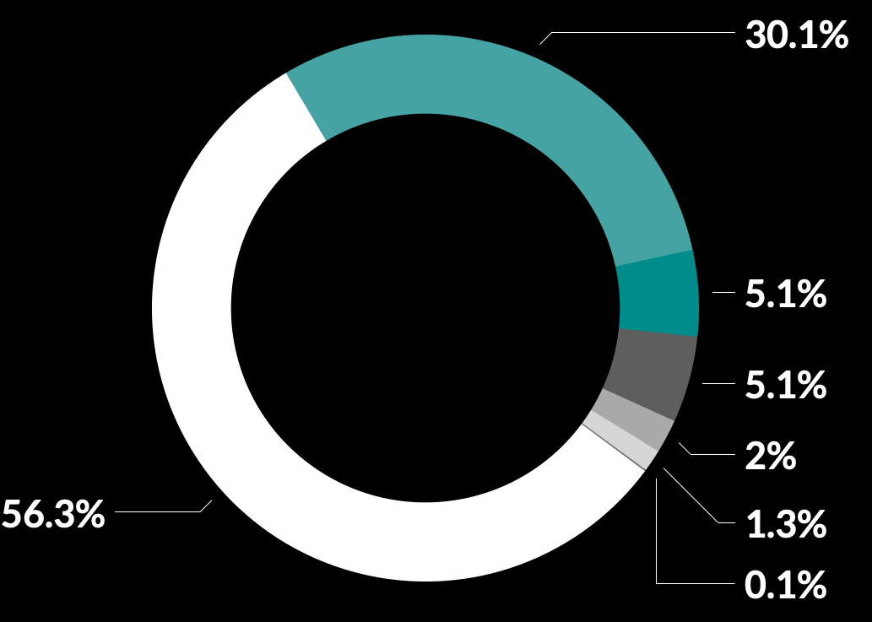
Instagram is the top channel for 2023
As shown on the previous page, social commerce has only grown over the years and today, more shoppers than ever before are engaging in social-first product discovery. According to a Statista report, global sales through social media platforms climbed to an estimated $992 billion in 2022. That figure is expected to hit $2.9 trillion by 2026.
According to the MikMak Shopping Index, Instagram drives the highest Purchase Intent Rates for eCommerce brands at 11.1 percent. YouTube follows with 7.3 percent. Facebook, Pinterest, and TikTok drive Purchase Intent Rates of 6.1, 4.2, and 3.5 percent, respectively.
In terms of Purchase Intent Clicks, Facebook drives the most in-market traffic for eCommerce brands at 56.3 percent. Fellow Meta channel, Instagram follows with 30.1 percent. TikTok and YouTube tie for third most Purchase Intent Clicks at 5.1 percent. Snap follows with 2.0 percent. Traffic for TikTok has been increasing incrementally year over year. Pay extra close attention to this channel during the holiday season.
*Purchase Intent Clicks: The number of times a shopper has clicked through to at least one retailer during a single session
Share of Purchase Intent Clicks by Channel, 2023
Purchase Intent Rate by Channel, 2023
Make your products discoverable

Slide 7
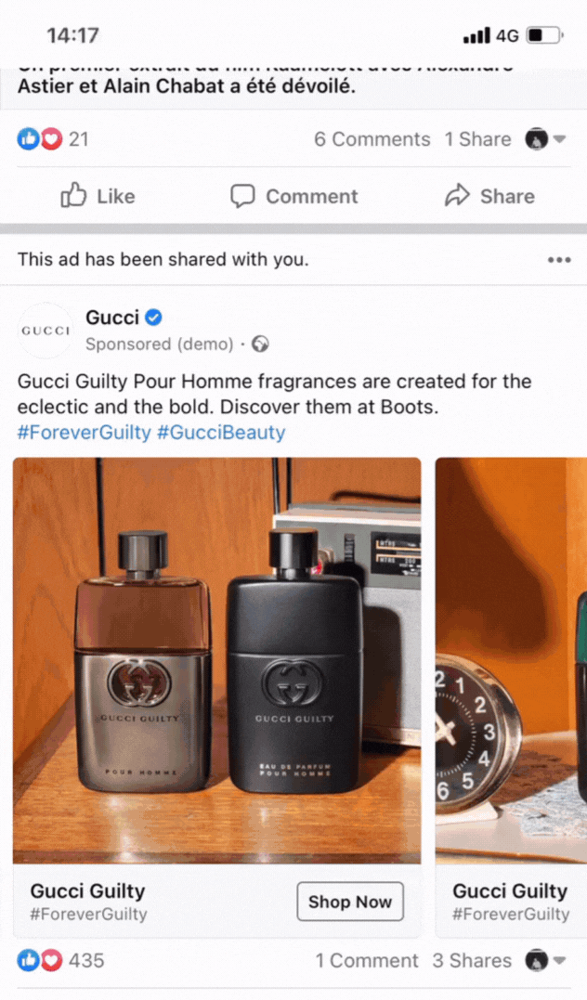
MikMak Commerce for Retail Media
Strengthen Retailer Partnerships
MikMak Commerce for Retail Media provides consistent and real-time reporting of retailer-specific performance data alongside national media investments including paid search, influencer media, display, video and more; empowering brands with the information needed to properly adjust and scale their retail media strategy.
According to a forecast from BCG, retail media spend is projected to more than double by 2027 to a $100 billion market. In 2015, retail media represented roughly 5 to 20 percent of brand budgets. Now, that figure is as high as 50 to 75 percent.
Despite retail media’s rapid growth and compelling value proposition, there are challenges that come along with it -- it is siloed, there is little to no standardization, there are gaps in reporting and there are few self-serve tools. By accessing and leveraging proprietary, retailer-specific consumer insights in joint planning discussions to unlock shelf space and media value, brands can strengthen retailer partnerships beyond retail media now and into the future.
Denise Woodward of Partake Foods explains how to scale a small business
“It’s tools like MikMak that give us the visibility on where our consumers are in the funnel from a consideration to purchase perspective and it allows us to support our retail partners.”
Strengthen Retailer Partnerships

Slide 8
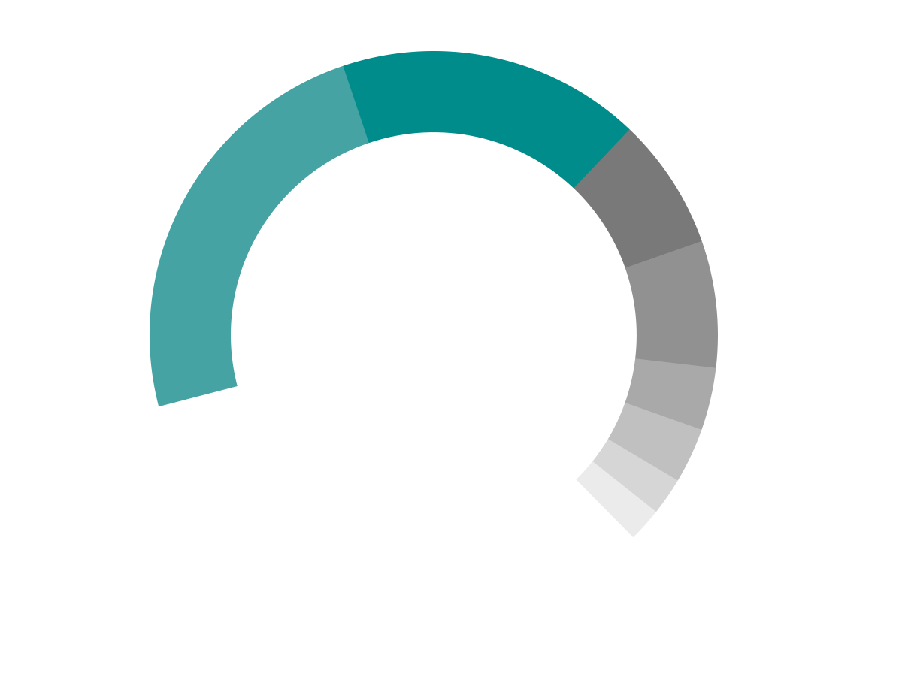
Walmart is the top retailer across categories this holiday season
Do you know which retailers your consumers prefer to check out at, and how that varies based on media platform, day of week and more? Be sure your media and brand website drive your consumers to the retailers they prefer to check out with.
According to the MikMak Shopping Index, Walmart is the highest driver of in-market traffic for all product types, driving 32.8 percent of Purchase Intent Clicks compared to the Top 10. Beyond that, Amazon drives 23.5 percent of PI Clicks, and Target at 17 percent.
Top 10 Retailers for 2023
Average Basket Size
by Share of Purchase Intent Clicks
2022
9 items
Basket Sizes are slightly smaller this year than last year, meaning consumers are buying less items per online shopping trip.
Now, more than ever, it is important to continue moving your supply. Partner with an eCommerce analytics software like MikMak to stay close to find real-time efficiencies in your strategy.
2023
7.7 items
Strengthen Retailer Partnerships

Slide 9
Inflation has changed what shoppers are buying
While the Consumer Price Index is lowering and inflation is overall cooling since last year, shoppers are still seemingly hesitant to purchase luxury items. Right now, the top products in the MikMak Shopping Index are largely everyday essentials such as car seats, grocery items, and household goods.
2023’s Amazon Prime Day showed us that consumers are taking advantage of promotions for their everyday needs, rather than splurging on big-ticket items. This is likely going to be the case for holiday promotions such as Black Friday and Cyber Monday.
Top Products by Purchase Intent Rate, All Categories
1. 2. 3. 4. 5. 6. 7. 8. 9. 10. | Car Seat Enchilada Sauce Glass Bakeware Laundry Detergent Children’s Playset Flavored Coffee Sliced Cheese Body Fragrance Veggie Burgers Toothbrush
“Overall inflation is starting to decline, as food and appliance prices stabilize. However, core inflation is continuing to impact consumers spending online. MikMak data indicates a YoY decline in eCommerce conversion rates, which coincides with inflation and interest rates continuing to rise. Consumers are spending, but they are spending on essentials. [...] It’s a further proof point that consumers are being more strategic about discretionary categories, and considering what they are willing to do on their own, like nails, versus paying for a service. This trend is likely to continue until inflation stabilizes.”
- Rachel Tipograph, Founder & CEO of MikMak, RetailToday
Strengthen Retailer Partnerships

Slide 10
Social Channel x Retailer Mix by Category
Beat the Competition
Knowing where consumers are buying your products and your competitors’ products will help you better understand how and where to position your brand, as well as where to spend your next dollar. Looking at MikMak Benchmark Insights will help uncover these trends.
Top 5 Social Channels by Purchase Intent Rate
Toys & Gaming
Beauty
x
x
A healthcare brand gained market share by leveraging MikMak Benchmark Insights to identify white space opportunities in their and their competitors' media mix
Brand Success Story
YouTube
Instagram
Twitter
Facebook
TikTok
Pinterest
Instagram
Facebook
YouTube
TikTok
15.8% Purchase Intent Rate through Google.
Grocery
Alcohol
3x Higher Purchase Intent Rate on Google than the category average Purchase Intent Rate.
x
x
YouTube
Pinterest
Instagram
Facebook
TikTok
Instagram
Facebook
YouTube
Twitter
Pinterest
+14% Increase in Purchase Intent Rate for the healthcare brand.
Beat the Competition

Slide 11
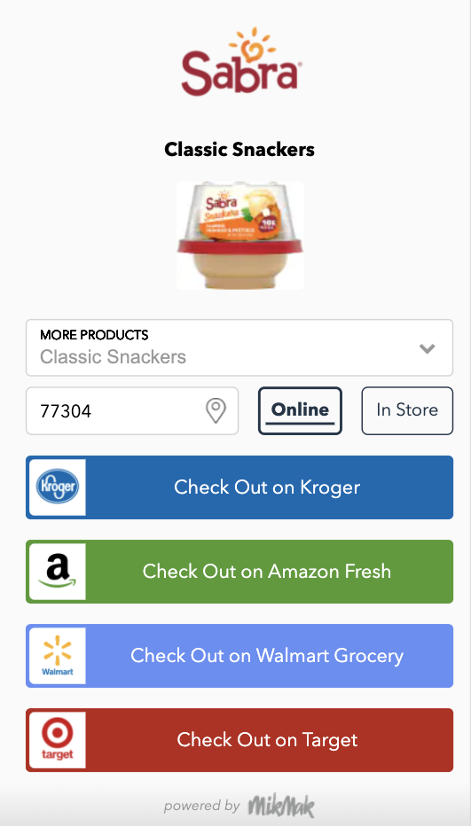
Drive Profitability and Reduce Costs
Sabra drove higher purchase intent than competitors and improved media efficiency by leveraging MikMak Insights to make campaign optimizations
Brand Success Story
Improve Marketing Effectiveness
Across eCommerce, shoppers are most likely to buy on Sunday at 2 PM ET. However, this varies across categories. Be aware of when and where to reach your consumers to put your media in front of them when they’re most likely to shop.
2x Increase in Purchase Intent Rate after switching campaign objectives
+86% Increase in Purchase Intent Rate after updating campaign creative
Sunday
Tuesday
Wednesday
Thursday
Monday
Top Days of The Week, by Purchase Intent Rate (All Categories)
+50% Higher Purchase Intent Rate than the Grocery vertical on Facebook/Instagram
2 PM
1 PM
5 PM
7 PM
8 PM
READ FULL CASE STUDY
Top Times of Day, by Purchase Intent Rate (All Categories, EST)
Improve Marketing Effectiveness

Slide 12
Toys & Gaming
by Purchase Intent Rate
Grocery
by Purchase Intent Rate
Beauty
by Purchase Intent Rate
Alcohol
by Purchase Intent Rate
Top Days of The Week
Top Days of The Week
Top Days of The Week
Top Days of The Week
Sunday
Saturday
Monday
Tuesday
Wednesday
Tuesday
Wednesday
Thursday
Monday
Saturday
Thursday
Sunday
Wednesday
Tuesday
Monday
Thursday
Wednesday
Tuesday
Friday
Monday
Top Times of Day (EST)
Top Times of Day (EST)
Top Times of Day (EST)
Top Times of Day (EST)
5 PM
4 PM
6 PM
1 PM
10 AM
1 PM
12 PM
2 PM
3 PM
4 PM
5 PM
2 PM
1 PM
8 PM
4 PM
7 PM
6 PM
8 PM
5 PM
2 PM
Improve Marketing Effectiveness

Slide 13
1. Feed-Based Video Ads
Creative Best Practices to Improve Marketing Effectiveness
Design with sound off in mind.
Capture attention within the first few seconds
Showcase your brand early and consistently throughout the video
Optimize for the 4:5 aspect ratio to maximize screen real estate
Experiment and try new approaches to engage viewers effectively
Using a variety of media types can help your brand reach omnichannel shoppers. Given that Facebook and Instagram remain top social channels for eCommerce this season, Disruptive Digital, alongside MikMak, put together some best practices for Meta.
2. Reels (and Story)
Keep it simple and highlight a single benefit or product
Try unconventional angles or perspectives to make your content stand out
Use varied layouts and interesting compositions
Create a focal point in the foreground to guide viewers' attention
Read More on How to Drive Omnichannel Sales on Meta from Disruptive Digital
3. Image Ads in the Feed
Consider the mobile best practices mentioned earlier
Tailor the messaging to resonate with the target audience's needs
Focus on your core products that drive the majority of omnichannel sales
Pay attention to merchandising to enhance the appeal of your ads
DOWNLOAD NOW
Improve Marketing Effectiveness

Slide 14
Collect first-party data
Purchase Intent Rates by Household
Having a consolidated view of your consumer data and target audiences can help you reach those who will buy your product with higher performance, at a lower cost.
Millennials and Households with one child are more likely to buy
Starting in 2025, we anticipate that commerce will experience a large shift as Gen Z approaches 30 years old, only adding to the vitality of consumer data for brands. Brands will be built on top of real-time consumer data that shows how we shop, how we identify, what our needs and wants are, and what causes us to buy or not.
Right now, we see that one-child households are likely to buy, and that Millenials and Gen Z have the most purchasing power when compared to other generations. Keeping an eye on this level of insights can help you tailor your advertising to audiences that will purchase your product.
Avg: 6.14%
Purchase Intent Rates by Generational Cohort
Collect first-party data

Slide 15
Top Demographic Cohort Audience by Category (by Purchase Intent Rate)
Brand Success Story
Aveeno Baby increased purchase intent by leveraging first-party data from MikMak Commerce to build new audience segments and optimize their media mix
Alcohol: Baby Boomer
Beauty: Gen X
1.25x Higher Purchase Intent Rate for campaigns using MikMak Audiences
Grocery: Millennial
31% Of Total Purchase Intent Clicks came from MikMak Audience segments
Health: Millennial
Household Goods: Baby Boomer
29% Of consumers preferred to shop at Target
Personal Care: Baby Boomer
Toys: Millennial
READ FULL CASE STUDY
Collect first-party data

Slide 16
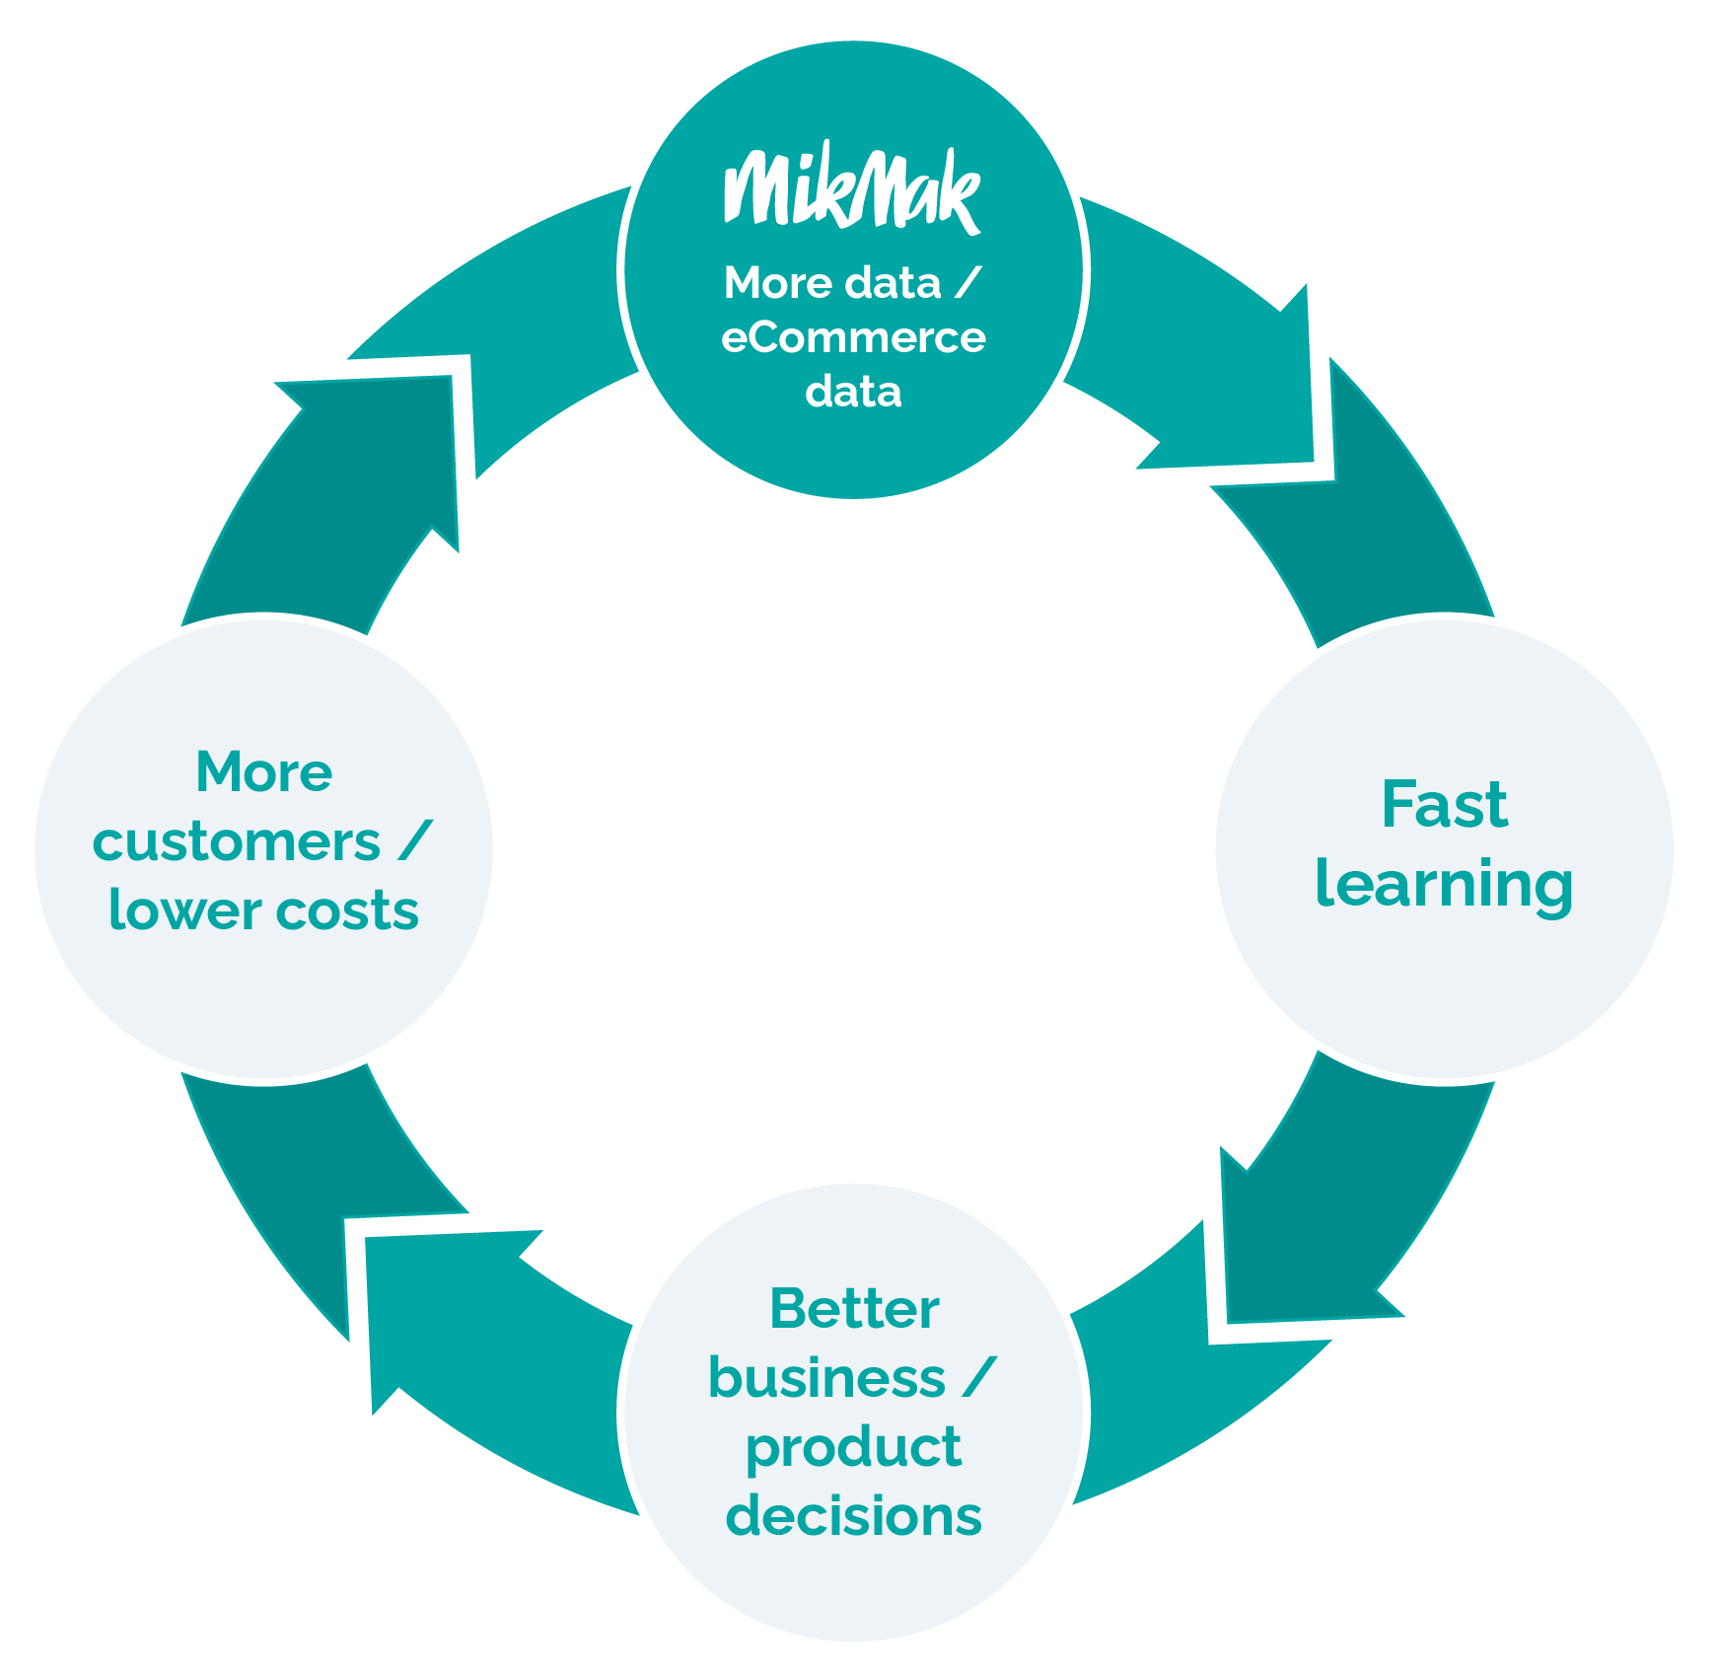
Save Time & Money
For an eCommerce strategy to be truly effective, sales must be connected back to how the buyer is shopping in real time. Brands must keep a close eye on the data to make sure they’re connecting with their consumers when they’re shopping.
Being agile and quick with your data, and focusing on your customer leads to brand growth. Here are just a few ways some of our brand partners are putting this strategy into action:
Internal sprint teams or “squads” - Form a small sub-team and give them a very specific question to answer or a hypothesis to prove in a short amount of time.
Specific agency briefs - Run a short, inexpensive test on social using MikMak to form the brief, and then ask them to build a creative amplification plan around it.
Question makers vs decision makers - the people internally that will truly help extract the most value out of eCommerce data aren't always the decision makers; they are the people who know how to ask big questions and rally teams around finding the answers. Make these people your allies.
Save Time & Money

Slide 17
Additional Resources
Global Social Commerce Trends, Tips, & Predictions for Multichannel Brands
State of Social Commerce Report: 2023
How to Use eCommerce Data to Accelerate Brand Growth
DOWNLOAD
DOWNLOAD
DOWNLOAD
Tap into some key holiday industries with these BRAVE COMMERCE episodes:
Toys try Kate Crowley and Luke Sebire of LEGO
Consumer Electronics listen to Jim Mollica from Bose
Alcohol we suggest this episode featuring Jay Sethi from Diageo
Sweets and Treats wisdom is packed into this episode with Mars' Anton Vincent
LISTEN NOW
LISTEN NOW
LISTEN NOW
LISTEN NOW

Slide 18
Your 2023 Holiday Cheatsheet
Be mindful of inflation-based buying trends. Consumers are price-sensitive and willing to change brands and retailers to get what they want.
Prepare early. Use the data and insights to fully optimize well before demand surges and the cost of media increases. If you anticipate the supply chain slowing down, incentivize earlier purchases.
Deals are starting earlier; advertise yours by directing consumers to the appropriate retailer.
Get creative in your media design, in your media mix, and in your partnerships. Test and learn discount messaging.
We're here to help. MikMak helps multichannel brands gain deeper consumer insights to grow and protect market share. Contact us at marketing@mikmak.com!
The MikMak Shopping Index was developed to provide a standardized set of metrics, methodology, and benchmarks to help drive brands’ business results and strategy. It is a collection of key eCommerce KPIs collected across hundreds of brands and over 250 channels and more than 4,000 retailer integrations to understand consumer online shopping behavior. The Index also includes data from MikMak Shopper Intelligence, which ties first-party eCommerce data to 1,000+ demographic and psychographic data points and can be segmented by product, retailer, and more. Shopper Intelligence is available through an industry-exclusive partnership with LiveRamp.
Data in this report is from June 10, 2022 - June 10, 2023

