Slide 1
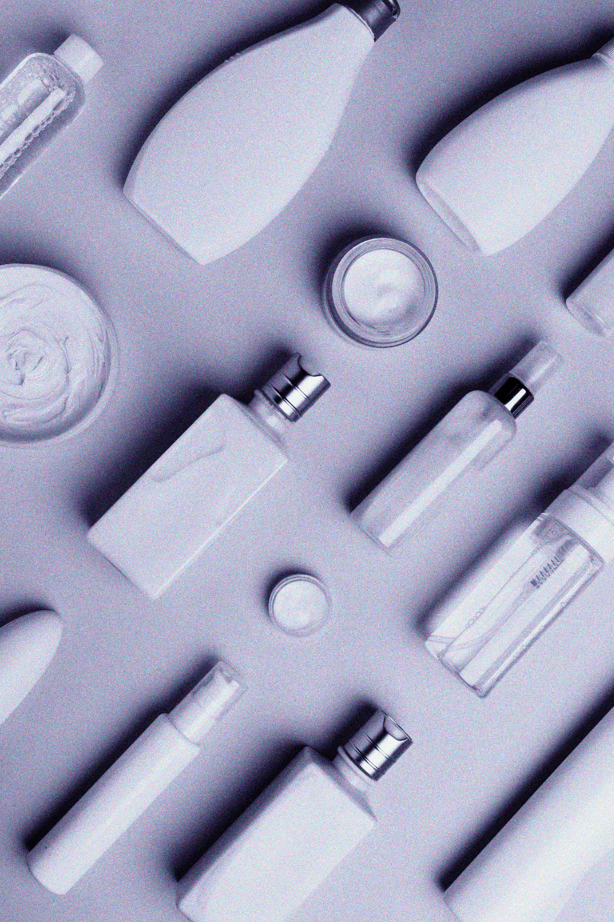
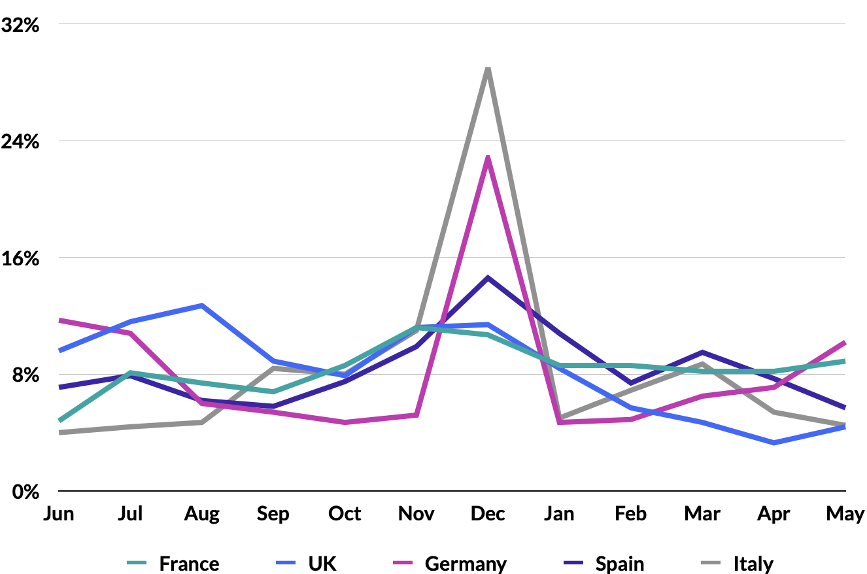
2023 eCommerce Guide
Beauty & Personal Care Benchmarks and Insights: Europe
From the MikMak Shopping Index
Share of Purchase Intent Clicks
by Month, Beauty

Slide 2
Beauty & Personal Care Benchmarks and Insights: Europe
Beauty and Personal Care: A Deep Dive into eCommerce in Key European Markets
While the proportion of online shoppers in EU countries grew from 55 percent in 2021 to 75 percent in 2022, Beauty has risen to be the third most popular category for eCommerce in Europe.
The five largest national markets for Beauty and Personal Care products in Europe are Germany (€13.6 billion), France (€12.0 billion), Italy (€10.6 billion), the UK (€9.9 billion), and Spain (€6.9 billion).
Valued at €80 billion in retail sales, Europe is one of the largest markets for Beauty and Personal Care products in the world.
In this guide, we take a look at the key European markets from an eCommerce perspective, illustrating shoppers’ engagement with multichannel Beauty and Personal Care brands.

Slide 3
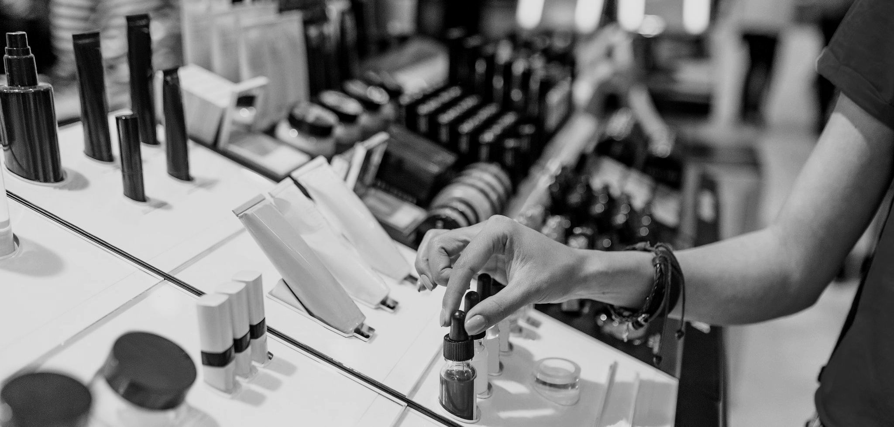
Beauty & Personal Care Benchmarks and Insights: Europe
The Power of Choice between Mass Merchant and Specialized Retailers
*Purchase Intent Clicks:
The number of times a shopper has clicked through to at least one retailer during a single session.
In terms of Purchase Intent Clicks*, an indicator of overall shopping traffic, Amazon ranks first among the Top 5 online retailers for Personal Care, leading this category in Italy and France. For Beauty, it also holds the top position in France with 25.2 percent of Purchase Intent Clicks.
In other countries, specialized retailers get the highest ranking. In the UK, Health and Beauty retailer Boots comes first, with 21.4 percent share of Purchase Intent Clicks in Beauty and 22.6 percent in Personal Care. Douglas is another key player. This perfume and cosmetics retailer, operating in 19 European countries, gets the highest score of Purchase Intent Clicks in the Beauty category in Germany with a staggering 47.5 percent share and in Italy with 26.5 percent. It also ranks within Top 5 retailers in the Spanish and Italian markets for Personal Care products. Sephora is not to forget in the mix, scoring very high in the top 5 in Europe, especially in France, Spain and in the UK.
Many Dermocosmetics and Personal Care brands are also sold by pharmacy networks, gaining importance in the retailer mix, like Shop-Apotheke in Germany, with 20.7 percent share of Purchase Intent Clicks.
Whenever and wherever online shoppers engage with your brand, across media as well as your brand website, make sure they are able to easily buy from any of their preferred retailers. Advertising on a mix of channels, and being available at a variety of specialized and mass merchant retailers, can help your brand win market share with Beauty and Personal Care shoppers.

Slide 4
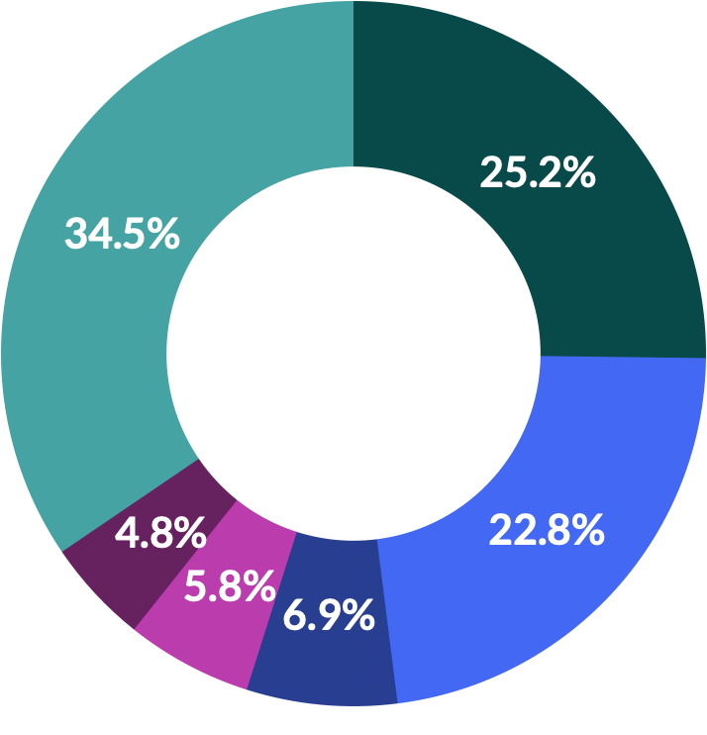
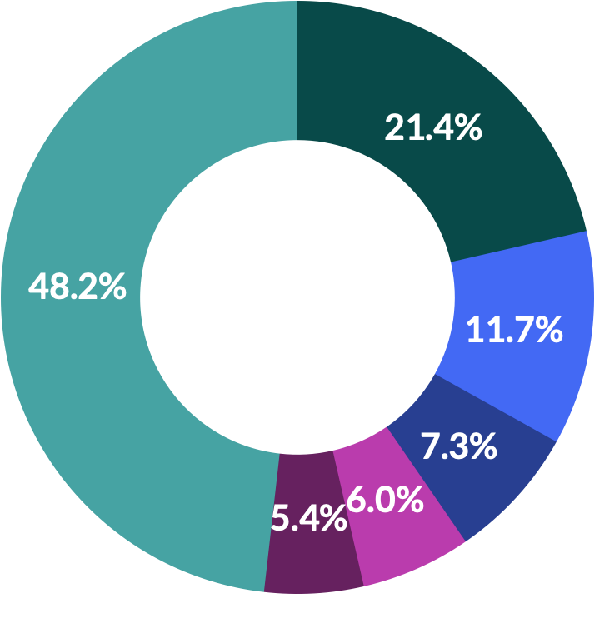
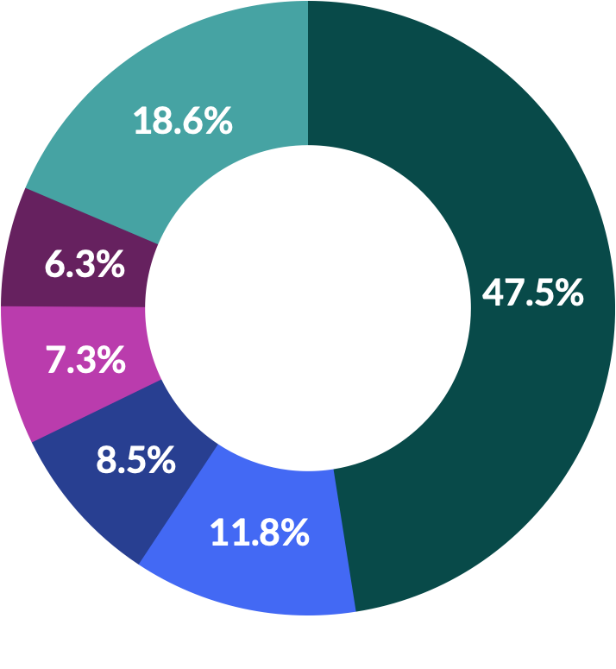
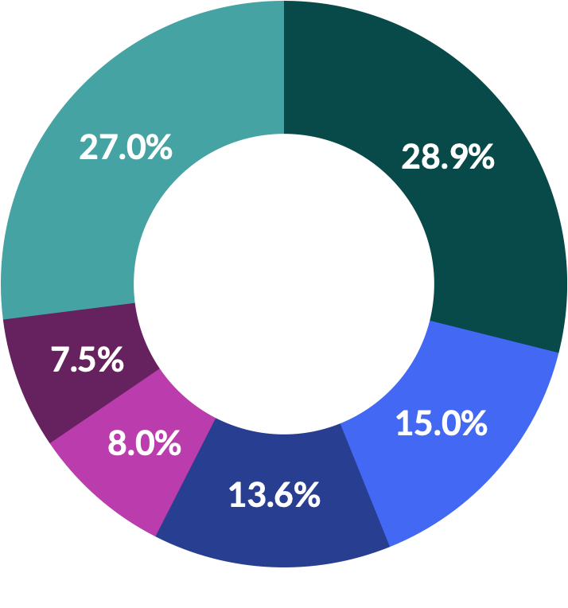
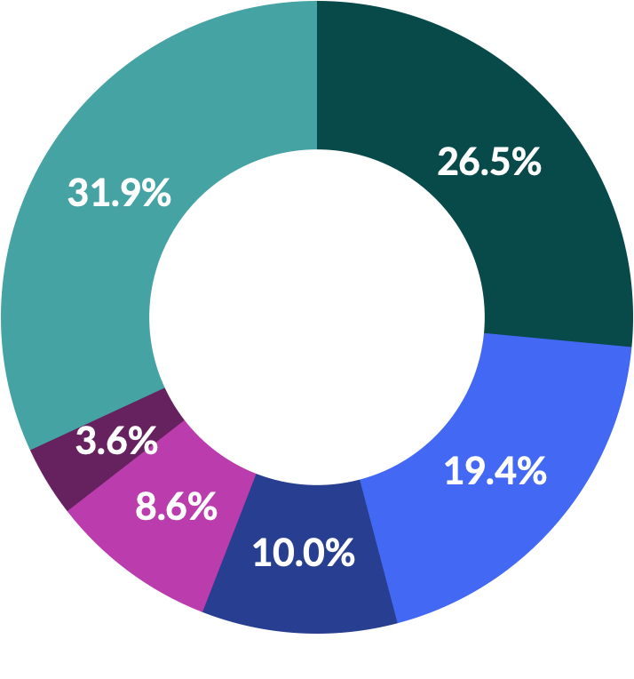
Beauty & Personal Care Benchmarks and Insights: Europe
Share of Top 5 Retailers by Purchase Intent Clicks, Beauty
FR
UK
DE
ES
IT
1
Amazon
1
Boots
1
Douglas
1
El Corte Ingles
1
Douglas
2
Nocibe
2
Amazon
2
Flaconi
2
Druni
2
Sephora
3
Sephora
3
Lookfantastic
3
Müller
3
Sephora
3
Pinalli
4
CDiscount
4
Sephora
4
Galeria
4
Douglas
4
Amoretti Profumi
5
Carrefour Drive
5
John Lewis
5
Parfumdreams
5
Perfume’s Club
5
Marionnaud
6
Other Retailers
6
Other Retailers
6
Other Retailers
6
Other Retailers
6
Other Retailers

Slide 5
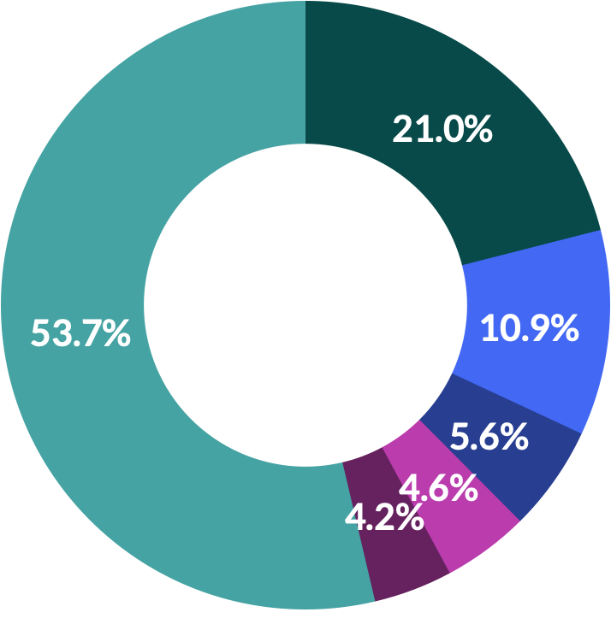
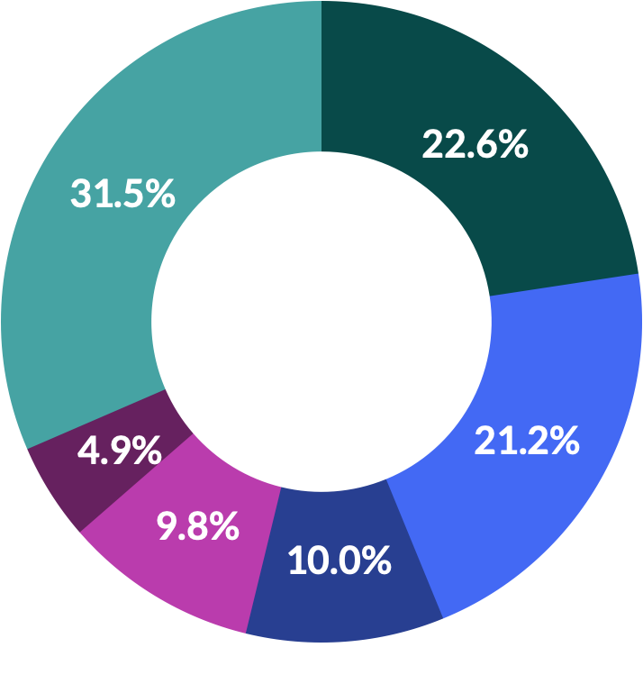
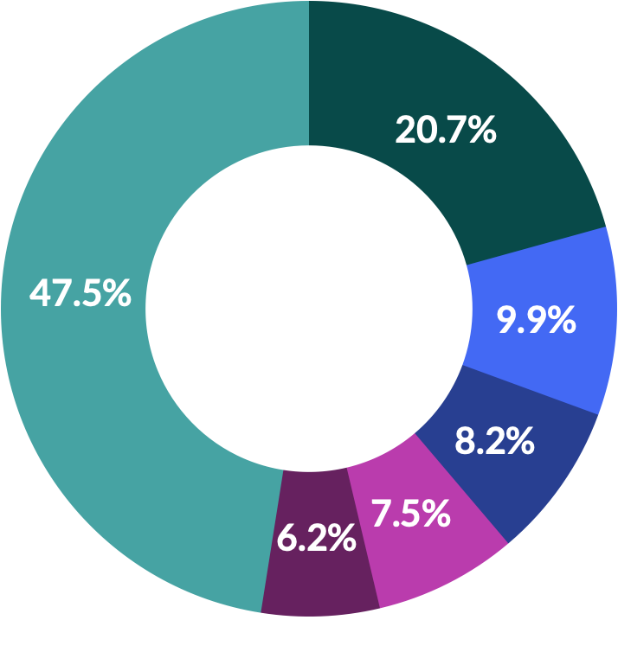
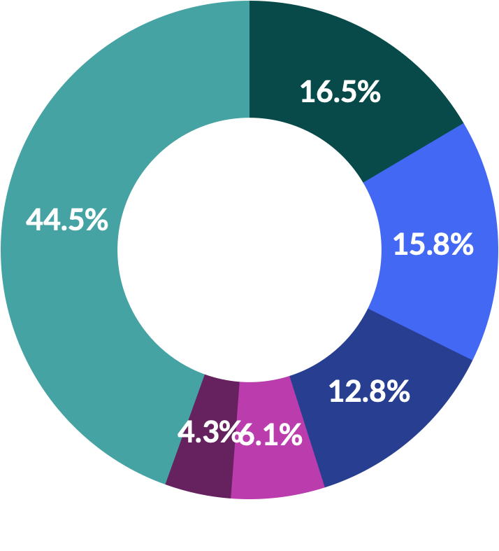
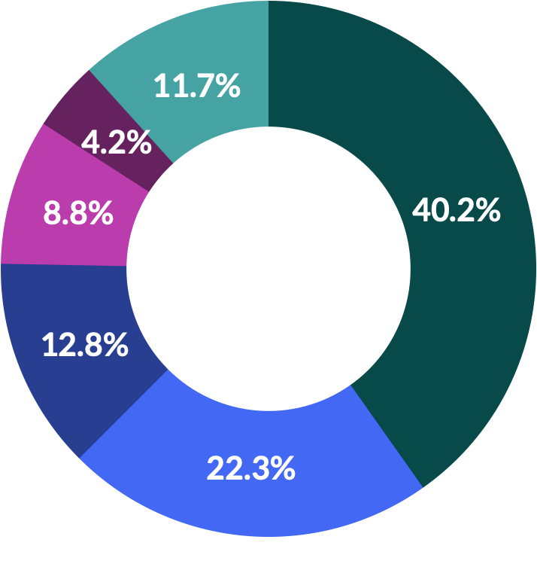
Beauty & Personal Care Benchmarks and Insights: Europe
Share of Top 5 Retailers by Purchase Intent Clicks, Personal Care
FR
UK
DE
ES
IT
1
Amazon
1
Boots
1
Shop-Apotheke
1
Amazon
1
Amazon
2
Nocibe
2
Amazon
2
DM
2
Primor
2
Farmaè
3
Cocooncenter
3
Sephora
3
Amazon
3
Druni
3
eFarma
4
Atida
4
Lookfantastic
4
Rossman
4
El Corte Ingles
4
Douglas
5
Carrefour Drive
5
Escentual
5
Müller
5
Carrefour
5
Carrefour
6
Other Retailers
6
Other Retailers
6
Other Retailers
6
Other Retailers
6
Other Retailers

Slide 6
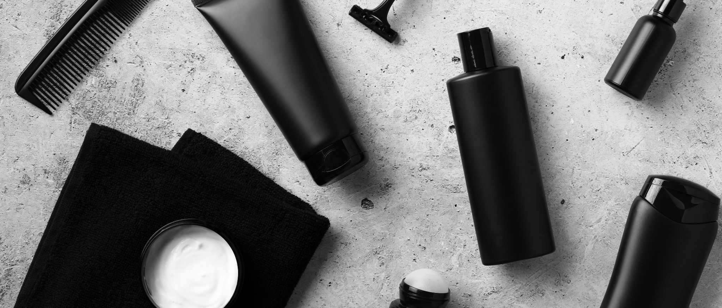
Beauty & Personal Care Benchmarks and Insights: Europe
Meta keeps scoring high in Europe for Social Commerce
Facebook vs Instagram: Highest Purchase Intent Rates by Country
Based on user numbers, the leading social media channels in Europe are Facebook, Instagram and TikTok. We notice that these three are also particularly popular when it comes to social commerce for Beauty and Personal Care brands.
Meta is leading in all five markets in Purchase Intent Rate*, a key indicator of shoppers’ likelihood to make a purchase. Instagram is performing especially well in Germany, Italy and France. In the UK and Spain, Facebook is the leading channel for Social Commerce.
Beauty and Personal Care brands should not forget other channels either. TikTok and Pinterest keep gaining importance, with Snapchat a little further behind. Youtube is among the top 3 most performing channels in Germany in Purchase Intent Rate and it’s not far behind in other countries either. With shoppers using several social media today, it’s important to test what works the best with your different audiences and product categories. Consistent measuring of Purchase Intent on all your channels is key to detect the best combinations to drive Commerce growth for your brand.
France, Germany, Italy
United Kingdom, Spain
*Purchase Intent Rate:
The percentage of shoppers who clicked through to at least one retailer.

Slide 7
Beauty & Personal Care Benchmarks and Insights: Europe
Share of Purchase Intent Clicks by Month, Beauty
Key celebration dates lead to peak shopping activity in Beauty eCommerce
Preparing for their end-of-year festivities, Beauty shoppers in Europe get highly active in November and December. This shows clearly in the share of Purchase Intent Clicks occurring during those months. In France, November with 11.2 percent of clicks and December with 10.7 percent of clicks are the year’s best months for Beauty. The trend is the same in other countries too. December scores the highest in Italy with 29.0 percent of Purchase Intent Clicks, followed by Germany with 22.8 percent and Spain with 14.6 percent.
In the UK, in addition to the November-December peak period, another important peak lands in the Summer, in July and August, with August beating even December with its score of 12.7 percent of Purchase Intent Clicks.
Note: The monthly share of Purchase Intent Clicks corresponds to the percentage of the total number of Purchase Intent Clicks of the year generated each month in each country.

Slide 8
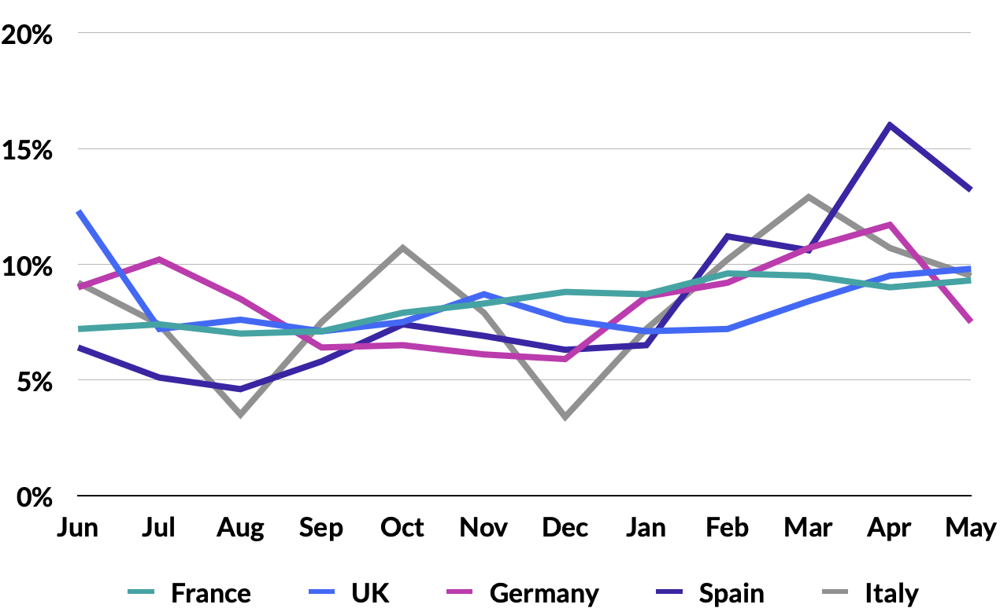
Beauty & Personal Care Benchmarks and Insights: Europe
When looking at Personal Care, shopping peaks are less evident. This category includes a lot of everyday products that are searched and purchased regularly throughout the year. Nevertheless, there are interesting high seasons that stand out.
For example, in Italy, the highest score of Purchase Intent Clicks is in March with 12.9 percent; and altogether the period from February to May is high activity. This coincides with the celebrations of Father’s Day 19th of March 2023 and Mother’s Day 14th of May 2023 in Italy.
Like the end-of-year festivities, Mother’s and Father’s Day represent major opportunities for Beauty and Personal Care brands to launch special campaigns and offers for gift hunters all over Europe.
​
It’s important to note that the key dates are not the same in each country and can vary from year to year. Look at the UK, where Father's Day is celebrated on the 3rd Sunday of June, the month which shows the highest share of Purchase Intent Clicks for Personal Care this year with 12.3 percent. The higher share of clicks in June may also be explained by the arrival of Summer and the increased need for suncare products.
Make sure to check the key sales dates and periods in each country, and update your strategy accordingly every year, so you won’t miss the momentum in your target markets.
Share of Purchase Intent Clicks
by Month, Personal Care
Note: The monthly share of Purchase Intent Clicks corresponds to the percentage of the total number of Purchase Intent Clicks of the year generated each month in each country.

Slide 9
Beauty & Personal Care Benchmarks and Insights: Europe
Most Popular Shopping Days of the Week, Beauty & Personal Care (By Purchase Intent Rate)
France
UK
Beauty and Personal Care shoppers are the most active from Sunday to Tuesday
1. 2. 3. | Sun Mon Tue | 4. 5. 6. | Sat Fri Wed | 7. | Thu
1. 2. 3. | Tue Wed Mon | 4. 5. 6. | Sun Thu Sat | 7. | Fri
Germany
Spain
Across all shoppable media and brand websites, we see the best Purchase Intent Rates on Sunday for Germany (46.0 percent) and France (29.4 percent). Sunday is high for the UK as well with 39.9 percent, but Tuesday scores the highest with 41.4 percent rate. In Spain, Tuesday (15.6 percent) is almost in par with Sunday (15.5 percent) as the best days. In Italy, Thursday has the best rate with 20.9 percent.
1. 2. 3. | Sun Tue Wed | 4. 5. 6. | Mon Thu Fri | 7. | Sat
1. 2. 3. | Tue Sun Mon | 4. 5. 6. | Thu Wed Fri | 7. | Sat
Italy
1. 2. 3. | Thu Mon Sun | 4. 5. 6. | Fri Sat Tue | 7. | Wed

Slide 10
Beauty & Personal Care Benchmarks and Insights: Europe
Share of Purchase Intent Clicks by
Day of the Week, Beauty & Personal Care
Tuesday is the best day of the week in Beauty and Personal Care for in-market traffic with 14.9 percent Purchase Intent Clicks in France, 15.7 percent in the UK and in Spain and 15.0 percent in Germany. In Italy, Purchase Intent Clicks are at the highest on Monday with 15.1 percent.
Friday and Saturday see slightly lower figures but Purchase Intent Clicks are increasing again on Sunday, especially in the UK (15.2 percent ), France (14.5 percent) and Germany (14.5 percent). Interestingly, compared to the US market, we discover that Europeans tend to look to buy products mostly from Sunday to Tuesday whereas in the US the weekends are the best days with 15.7 percent Purchase Intent Clicks on Saturday and 14.9 percent on Sunday.
Overall, Beauty shoppers are quite active during the whole week, with no big gaps, so you can easily engage with your audience any day.
France
UK
Germany
Spain
Italy
Note: The daily share of Purchase Intent Clicks corresponds to the percentage of the total number of Purchase Intent Clicks of the year generated each day of the week in each country.

Slide 11
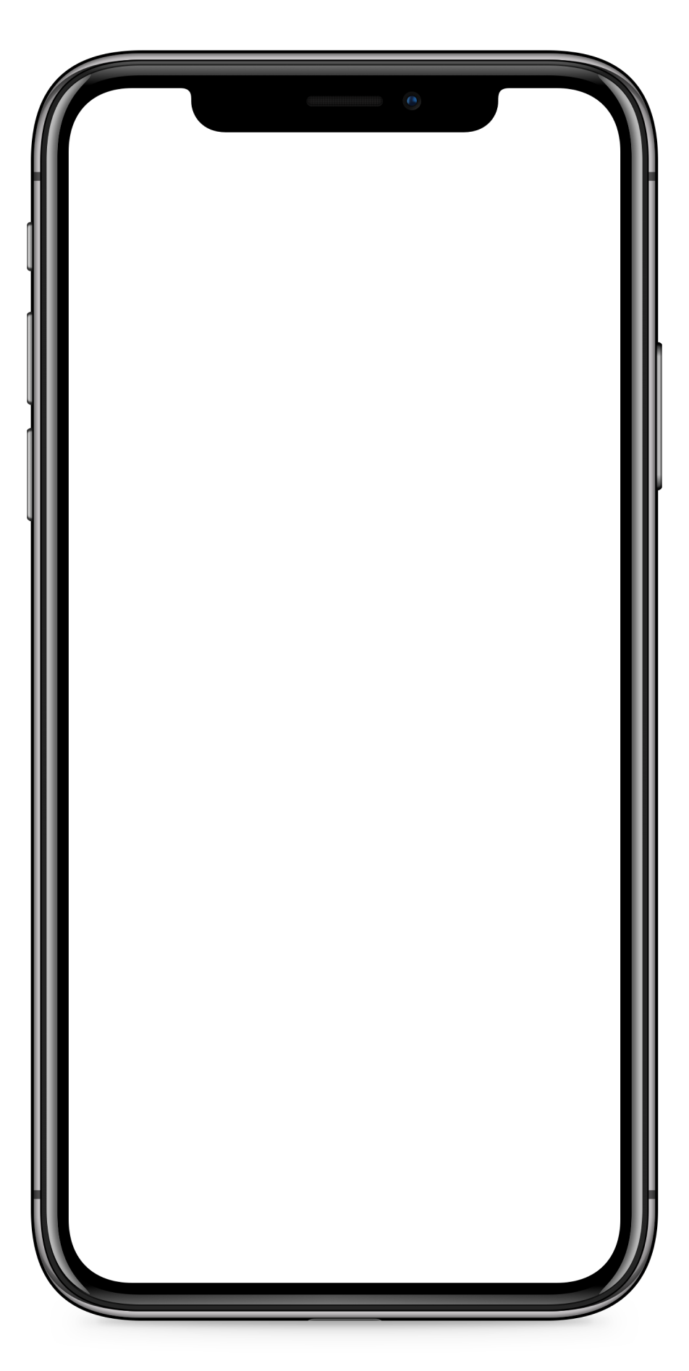
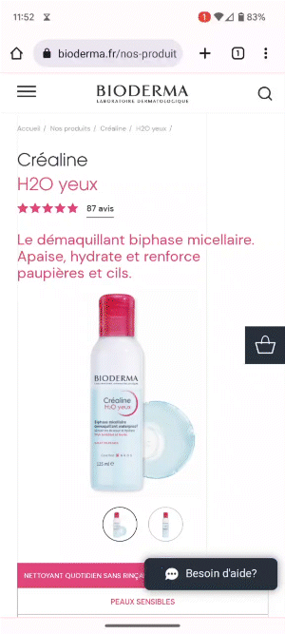
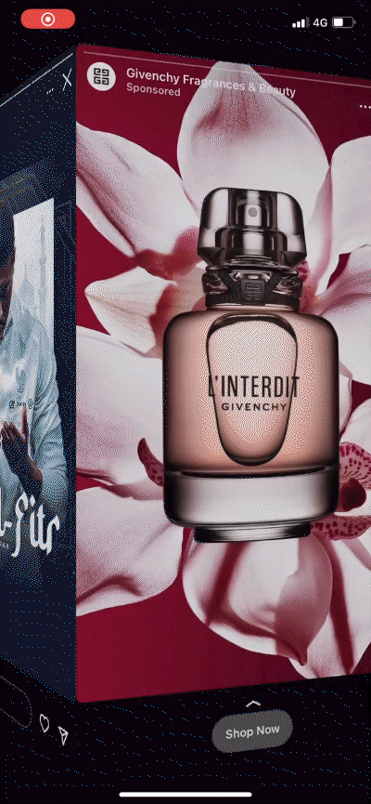
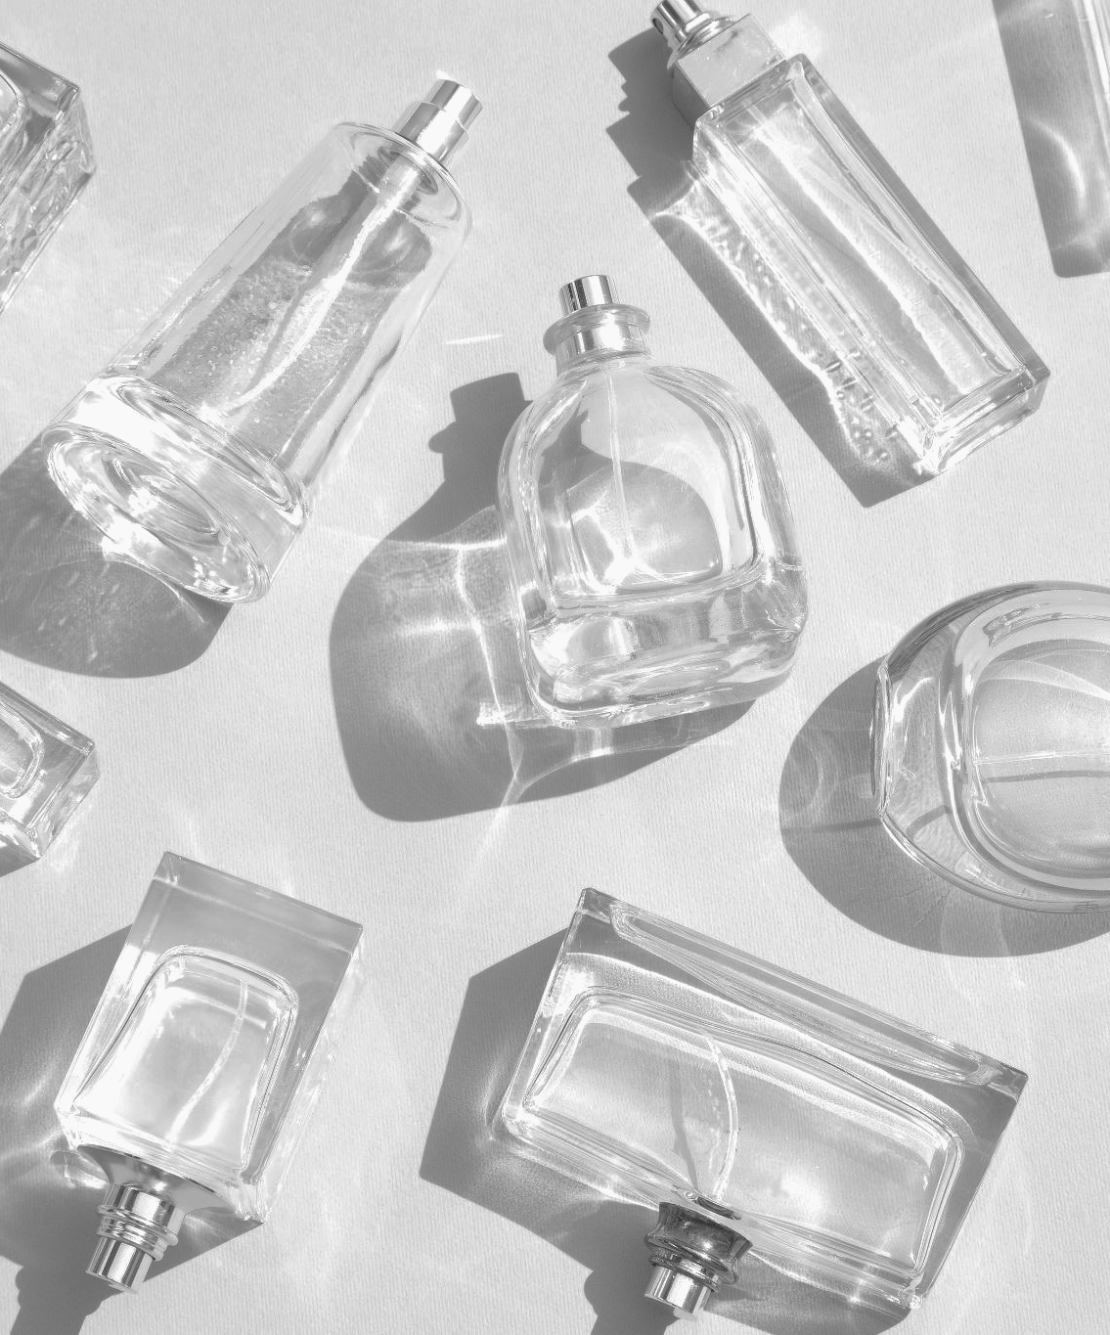
Beauty & Personal Care Benchmarks and Insights: Europe
What makes effective eCommerce ads?
Enable eCommerce capabilities on your brand websites and all media
What do many of the top-performing Beauty and Personal Care eCommerce ads have in common? Let’s take a closer look and find out:
Bold, eye-catching creative that visually stands out
Product first, showcasing both the product and its value right away
A clear call to action entices customers. Include bold links with simple text such as “Buy Now” or “Check Out”.
Flexible checkout that allows shoppers to switch between in stores and online
Optimize your content with MikMak to allow consumers to find your product locally
Don’t be afraid to try out different formats. Livestreaming, QR codes, and OTT advertising could all drive success for eCommerce Beauty and Personal Care brands
Enable shoppable options on your brand website to promote brand awareness and offer additional checkout and fulfillment options for shoppers.
“MikMak enables us to create seamless shopping paths for our audiences on our brand websites and social media, while measuring purchase intent and sales at our retailers. With key insights into shopper preferences, we can optimize our digital marketing strategy. Fantastic team and technology!"
- Digital & CRM Manager, LVMH Fragrance Brands

Slide 12
Beauty & Personal Care Benchmarks and Insights: Europe
Your eCommerce Marketing Checklist
So you’ve got the insights, now what? Here’s a list to help you design and optimize your eCommerce marketing initiatives for 2023.
Get the basics down. Is Boots on top of your check-out options in the UK? Douglas in Germany? Are you driving traffic to Druni and Primor in Spain too? Don’t forget, in addition to Amazon and mass merchants, specialized retailers are key to driving your eCommerce in the Beauty and Personal Care sector in Europe.
Develop more nuanced insights for consumer relevance. Is your brand’s website utilizing multi retailer checkout? Which channels are part of their shopping journey? Add the channels and retailers that resonate with your consumers to the mix. Can this expand to new formats like livestream and CTV?
Explore growth opportunities. Check your performance against category (and subcategory!) benchmarks to see how you stack up against the competition. A/B test creative and messaging to see if purchase intent increases.
Want to learn more? MikMak can help you get started!
"With MikMak, shoppers can easily choose where to buy our products, and we get to see what drives conversion at both our DTC and our Retailer sites."
- Performance Marketing Manager

Slide 13
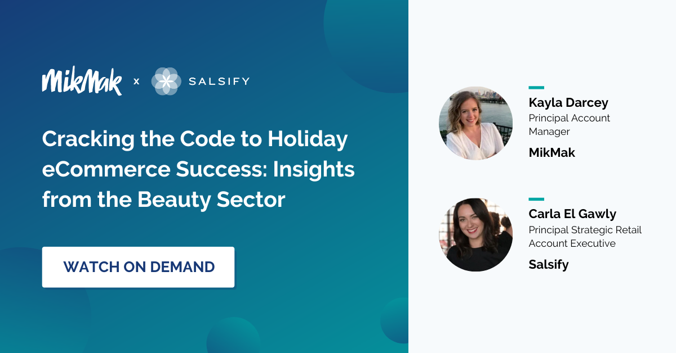
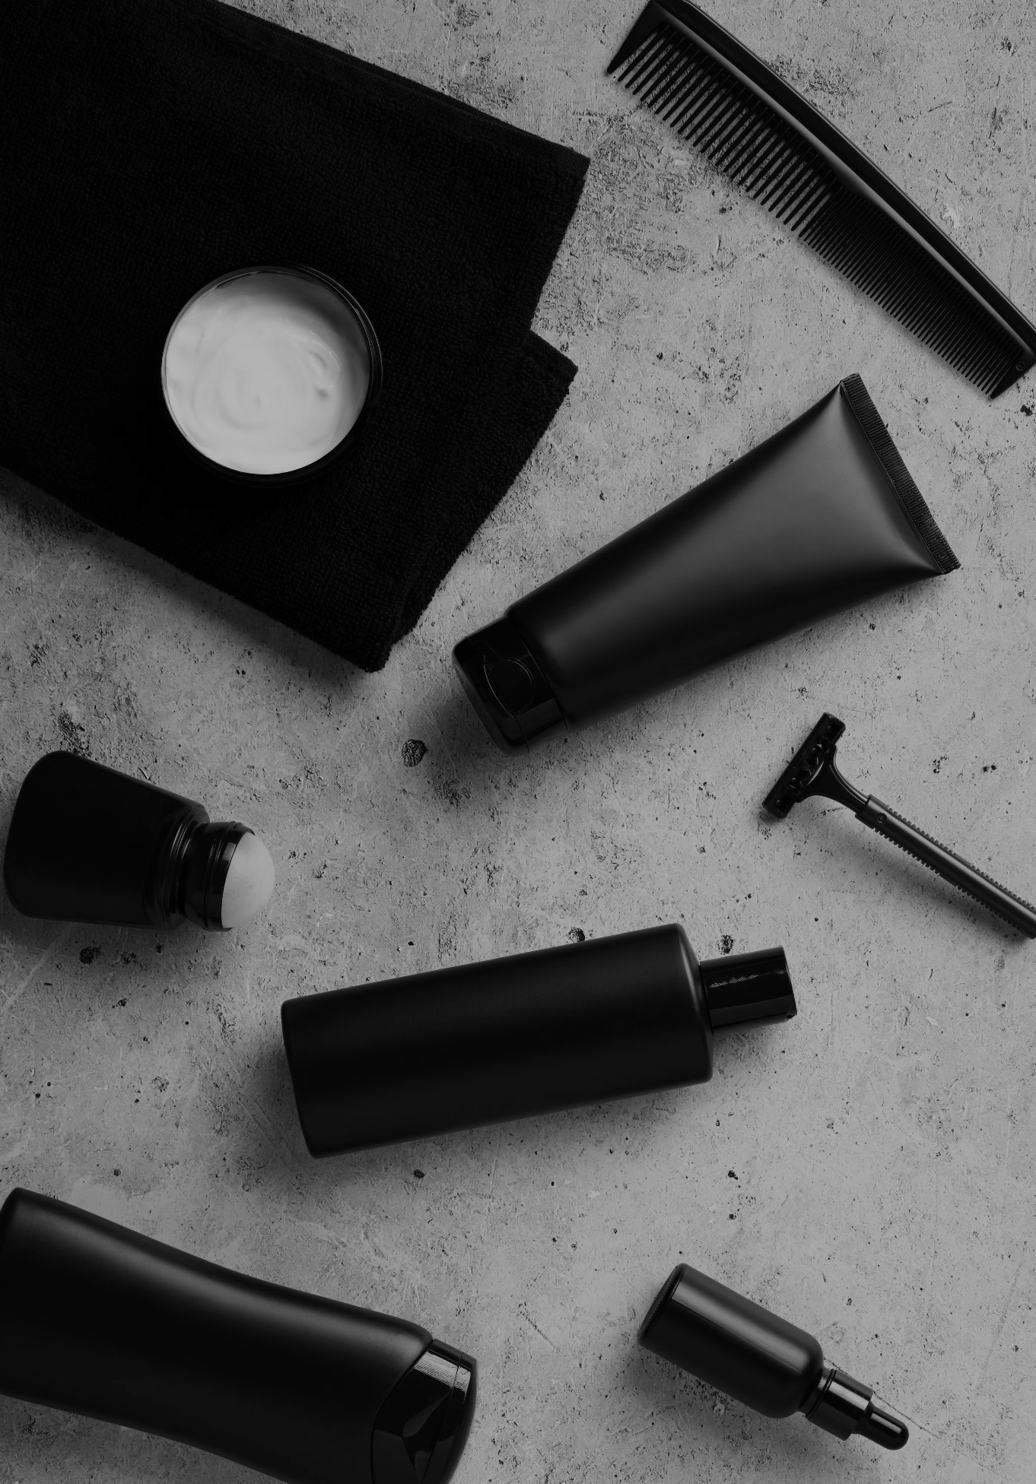
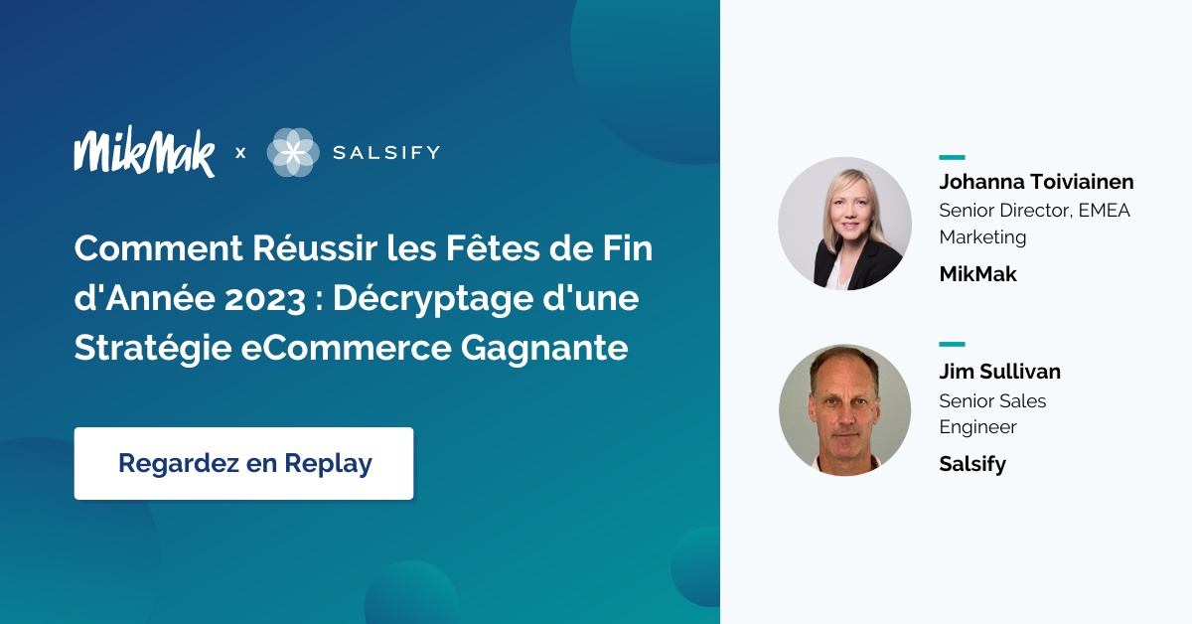
Download our Beauty Webinar available in French and English

Slide 14
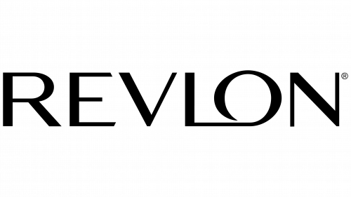
Want to keep learning about beauty insights?
All data and insights from this Category Benchmark and Insights are sourced from the MikMak Shopping Index.
The MikMak Shopping Index was developed to provide a standardized set of metrics, methodology, and benchmarks to help drive brands’ business results and strategy. It is a collection of key eCommerce KPIs collected across hundreds of brands and over 250 channels and more than 3,000 retailer integrations to understand consumer online shopping behavior.
Data in this report is from June 1, 2022 - May 31, 2023. Five European countries were analyzed with Beauty and Personal Care brands from France, Germany, Italy, Spain and the United Kingdom.
Check out these BRAVE COMMERCE episodes:
LISTEN NOW
LISTEN NOW
LISTEN NOW
TikTok's Sandie Hawkins on Revolutionizing eCommerce through Community | Urban Decay's Malena Higuera on the digital transformation of the beauty industry | Revlon CEO Debbie Perelman on capturing a truly omni-experience for consumers in 2021
Let’s chat!
Want to get even more insights?
Contact marketing@mikmak.com!

