Slide 1
Target Benchmarks & Insights Report
From the MikMak Shopping Index

Slide 2
Target Benchmarks and Insights Report
Consumer preference for Target eCommerce has shifted
TikTok has emerged as a top social commerce platform for Target shoppers in the last year
Grocery products drive the most online shoppers to Target
Sunday evening is the best time to reach Target shoppers
Here are the latest Target eCommerce findings for your 2023 marketing initiatives.

Slide 3
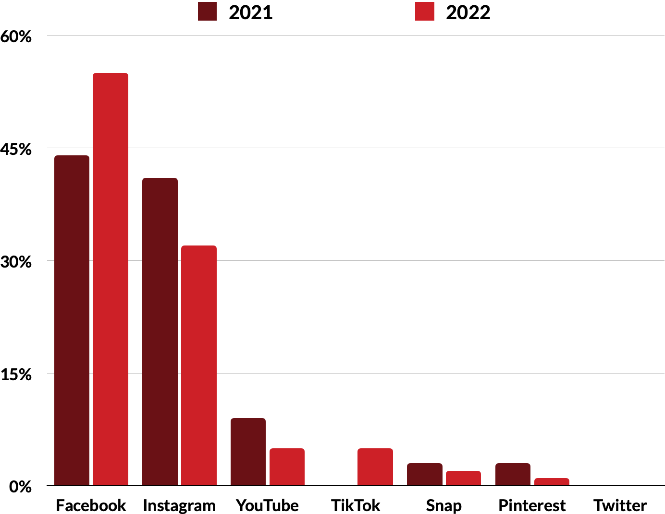
Target Benchmarks and Insights Report
Social Platform Share of Purchase Intent Clicks to Target
Use a strategic mix of social commerce ads.
While Facebook (55%) and Instagram (32%) remain staple channels for driving brand media traffic (Purchase Intent Clicks*) to Target, YouTube and TikTok follow at 5 percent. Snap and Pinterest are also channels that some brands are using to drive traffic to Target driving 2 percent and 1 percent, respectively.
This indicates a shift that occurred last year from the top social channels for Target in 2021, where TikTok drove 0 percent of in-market traffic. YouTube saw a dip in traffic in the past year, driving 9 percent of Target’s Purchase Intent Clicks in 2021. Meanwhile, YouTube and Pinterest both saw a slight dip after both driving 3 percent of traffic for Target in 2021.
*Purchase Intent Clicks:
The number of times a shopper has clicked through to at least one retailer during a single session.

Slide 4
Target Benchmarks and Insights Report
What brand categories matter most?
In 2021, this category mix looked different. Personal Care took the top spot, followed by Grocery, Toys, Beauty, and Household Products.
Target offers a wide array of product categories both in-store and online, but which ones are seeing the most purchase intent from eCommerce shoppers?
Currently, grocery takes the lead as the top product category for Target shoppers on the MikMak Platform, with 29.4 percent of Grocery shoppers clicking through to the retailer from brands’ media. Personal Care and Toys come next, at 14.3 percent and 12.7 percent, respectively.
Top Categories for Target Shoppers, 2022
1 Grocery
2 Personal Care
3 Toys
4 Infant Care
5 Beauty
Top Categories for Target Shoppers, 2021
Channel x Category Mix (Traffic)
1 Personal Care
2 Grocery
3 Toys
4 Beauty
5 Home Care
X Grocery

Slide 5
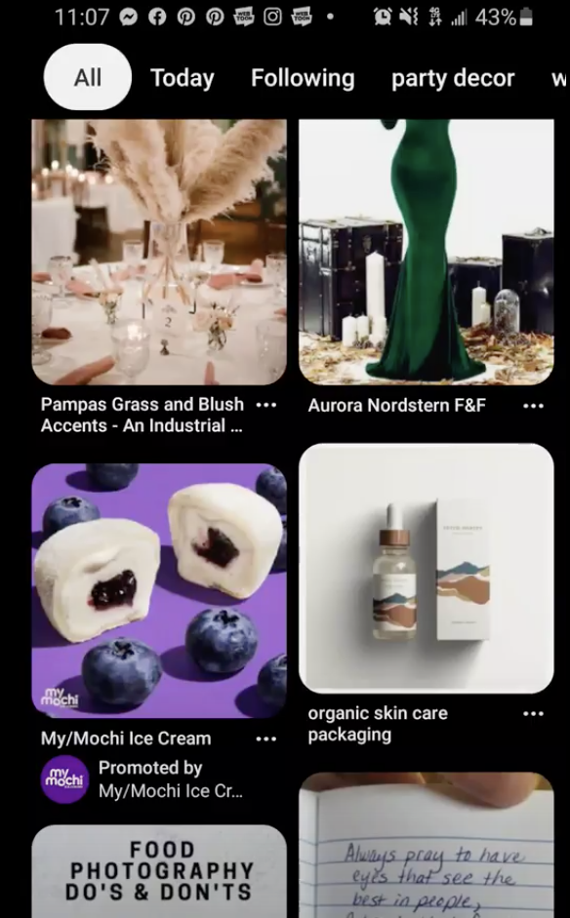
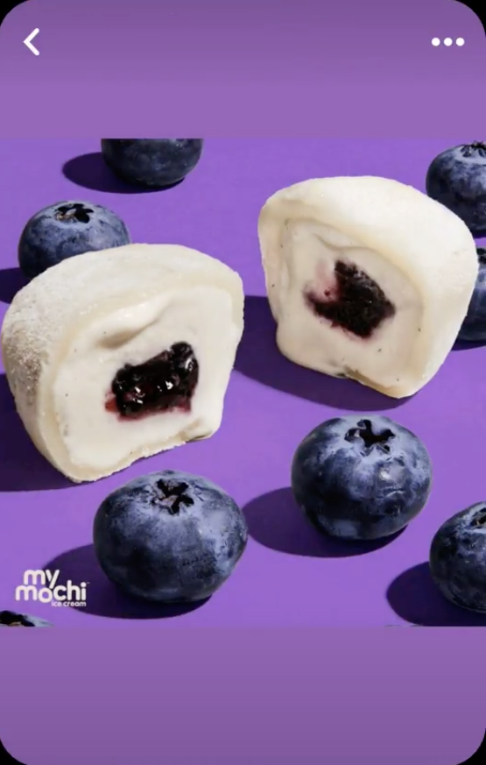
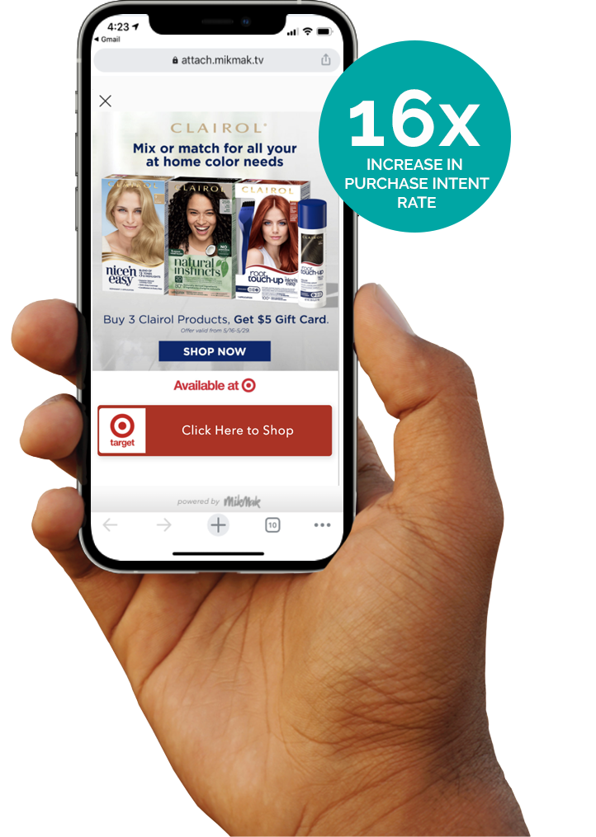
Target Benchmarks and Insights Report
Grocery spotlight
Target shoppers put between 4 and 5 items in their basket
Given that Grocery is the top product category Target shoppers are active in, here are a few tips and data points for brands in the category.
What makes effective eCommerce ads?
On average, Target eCommerce shoppers have 4.62 items in their shopping carts, valued at an average of $55. Most of the most popular items they’ve put in their carts in the past year are in the Grocery category, with some Toys and Household Products. The most popular products are as follows:
Bold, eye-catching creative that visually stands out
Product first, showcasing both the product and its value right away
1. Bananas
2. Distilled water
3. Strawberries
4. Milk
5. Eggs
6. Avocado
7. Blueberries
8. Toy Truck
9. Soda Pop
10. Paper Towels
Have a clear call to action. Include bold links with simple text such as “Buy Now” or “Check Out”.
Flexible checkout that allows shoppers to switch between in stores and online, different geolocations, fulfillment options, and checkout options on your brand website to provide various commerce options to reach consumers.
Clairol Case Study
Clairol drove a major lift in sales at Target by leveraging MikMak Sales Insights to inform creative, messaging, and landing page optimizations
Hot tip: Be quick and nimble with your creative. The world needs to be able to experience your brand and buy it.
READ NOW

Slide 6
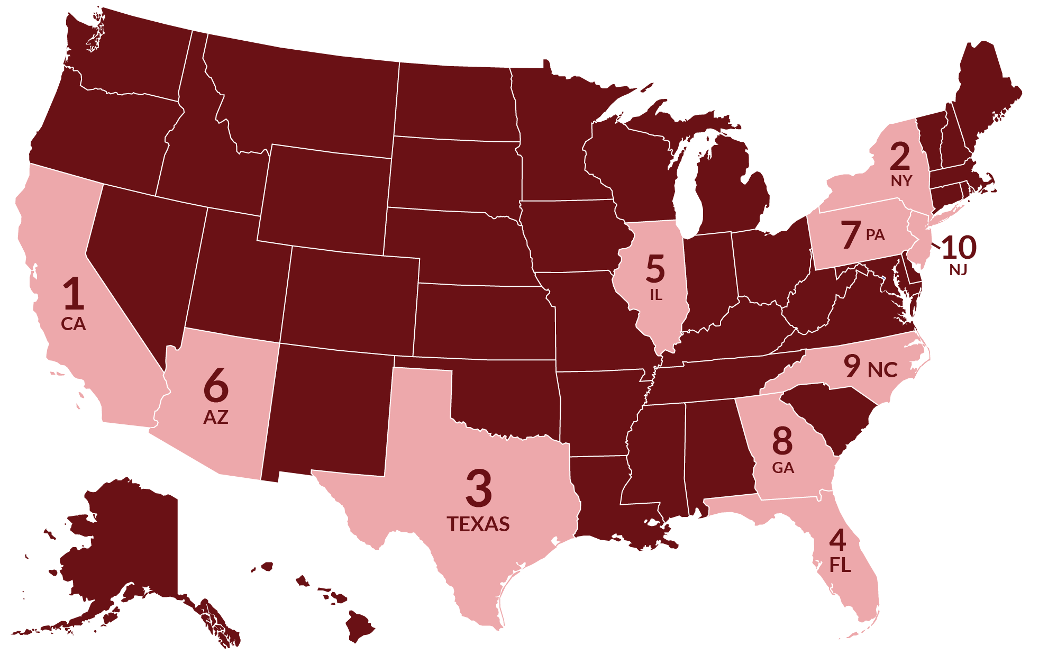
Target Benchmarks and Insights Report
Date x Time Mix
SUNDAY @ 9PM
Where are Target shoppers, and when are they shopping?
The majority of shoppers on the MikMak Platform who select Target as their retailer of choice reside in New York City, driving 10 percent of traffic. Next up are Los Angeles (6%), Chicago (5%), and Phoenix (4%). However, when looking at the data by state, California takes the lead, followed by New York, Texas, and Florida.
When do they shop the most? According to the MikMak Shopping Index, Saturday and Sunday see the most shopping activity from Target shoppers. In general, evening hours seem to be best.
Most Popular Shopping Days of Week: Target, 2022
Most Popular Shopping Time of Day: 2022 (In the shoppers’ local time zones)
9pm
10pm
8pm
4. 7pm
5. 6pm
6. 5pm

Slide 7
Target Benchmarks and Insights Report
Your eCommerce Marketing Checklist
So you’ve got the insights, now what? Here’s a list to help optimize your Target marketing initiatives for 2023.
Get the basics down. Are Facebook, Instagram, YouTube, and TikTok part of your marketing mix? Are you marketing to Target shoppers in the right regions, at the right time, and day of the week? Does your brand utilize its brand website effectively, by offering multi retailer checkout?
Explore joint growth opportunities. Retailers and brands have shared goals: selling more products and earning more revenue. To achieve these goals, it helps to be on the same page and look at the same data. Sharing data leads to more complete insights and more productive relationships.
Stay close to the data, daily. What matters most to your consumers? How does this vary by geography, platform, demographics, and more? Finding out the answers to these questions is the first step in improving your consumer insights and position with retailers, and results in stronger relationships and sales. This can all be done in real time within the MikMak Platform.
Want to learn more? Schedule a demo here.

Slide 8
All data and insights from Retailer Benchmark Reports are sourced from the MikMak Shopping Index
Let’s chat!
Want to get even more insights? Looking for a different retailer?
Contact marketing@mikmak.com!
The MikMak Shopping Index was developed to provide a standardized set of metrics, methodology, and benchmarks to help drive brands’ business results and strategy. It is a collection of key eCommerce KPIs collected across hundreds of brands and over 250 channels and over 2000 retailer integrations to understand consumer online shopping behavior. The Index also includes data from MikMak Shopper Intelligence, which ties first-party eCommerce data to 1000+ demographic and psychographic data points, and can be segmented by product, retailer, and more. Shopper Intelligence is available through an industry exclusive partnership with LiveRamp.
Data in this report is from 1/1/2021 to 12/31/2022

